Slide 1

IBM CLOUD
Managed Redhat Openshift
by IBM Cloud on Azure using IBM Satellite
Vann Lam
Last update: 2022-05
© 2022 IBM Corporation
Notes:
Author: Lionel Mace – lionel.mace@fr.ibm.com

Slide 2
Introduction
In this document, we will be provisioning a ROKS cluster in an IBM Cloud satellite location hosted in an Azure account.
We will be using an IBM Cloud account, a Microsoft Azure account.
On Azure account, we will be provisioning VMs, for ….

Slide 3
Prereq on getting started on ROKS on Azure with IBM Cloud Satellite
You need to have an IBM Cloud account
You need to have a Microsoft Azure account
(Azure Client ID, Azure tenant ID and Azure secret key) are sufficient

Slide 4
Steps to get started on ROKS on Azure with IBM Cloud Satellite
Create an IBM Cloud location on Azure
Deploy ROKS on the location
Create an image registry in ROKS to a COS bucket
Deploy Portworx on ROKS
Deploy ODF on ROKS

Slide 5
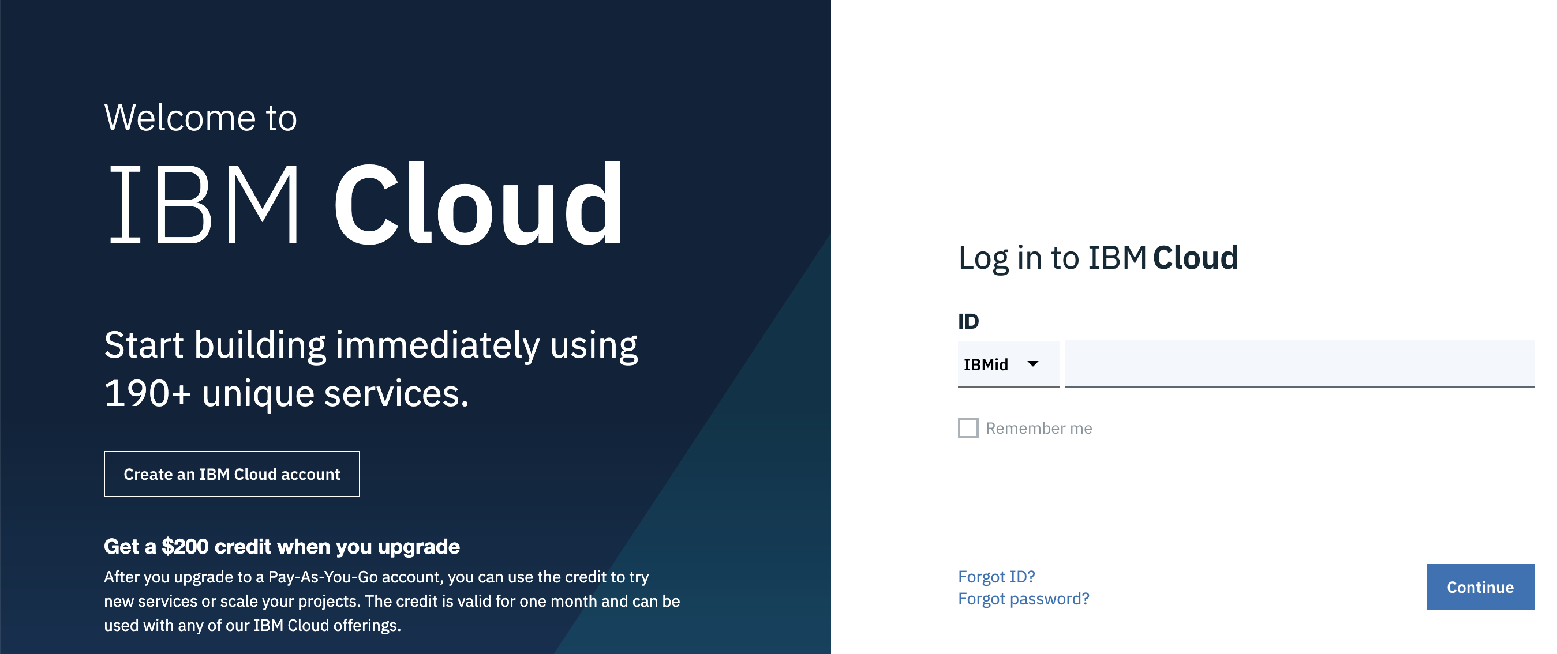
Log in to IBM Cloud with IBMid on a web browser
http://cloud.ibm.com

Slide 6
Log in to IBM Cloud with CLI
IBM Cloud CLI installation :
https://cloud.ibm.com/docs/cli?topic=cli-install-ibmcloud-cli
ibmcloud login
Use your IBMid credentials
ibmcloud login --sso
Use your enterprise credentials
Log in to Microsoft Azure with CLI
az login --service-principal
-u < Azure Client ID >
-p < Azure key >
--tenant < Azure tenant ID >

Slide 7
1. Create an IBM Cloud location on Azure

Slide 8
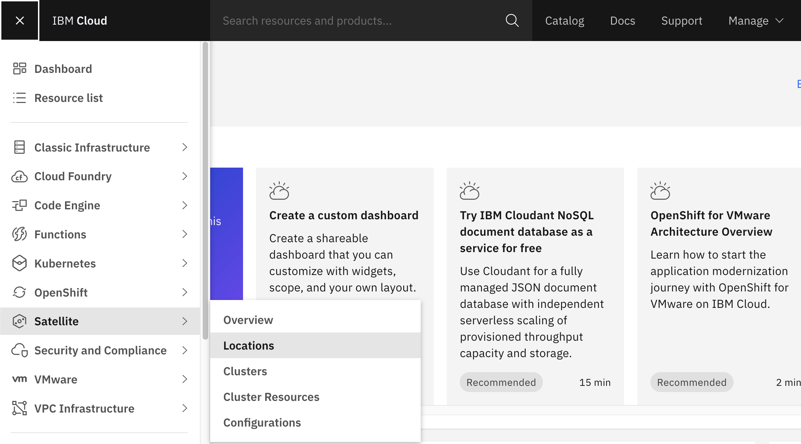
Go to Satellite Locations
1

Slide 9
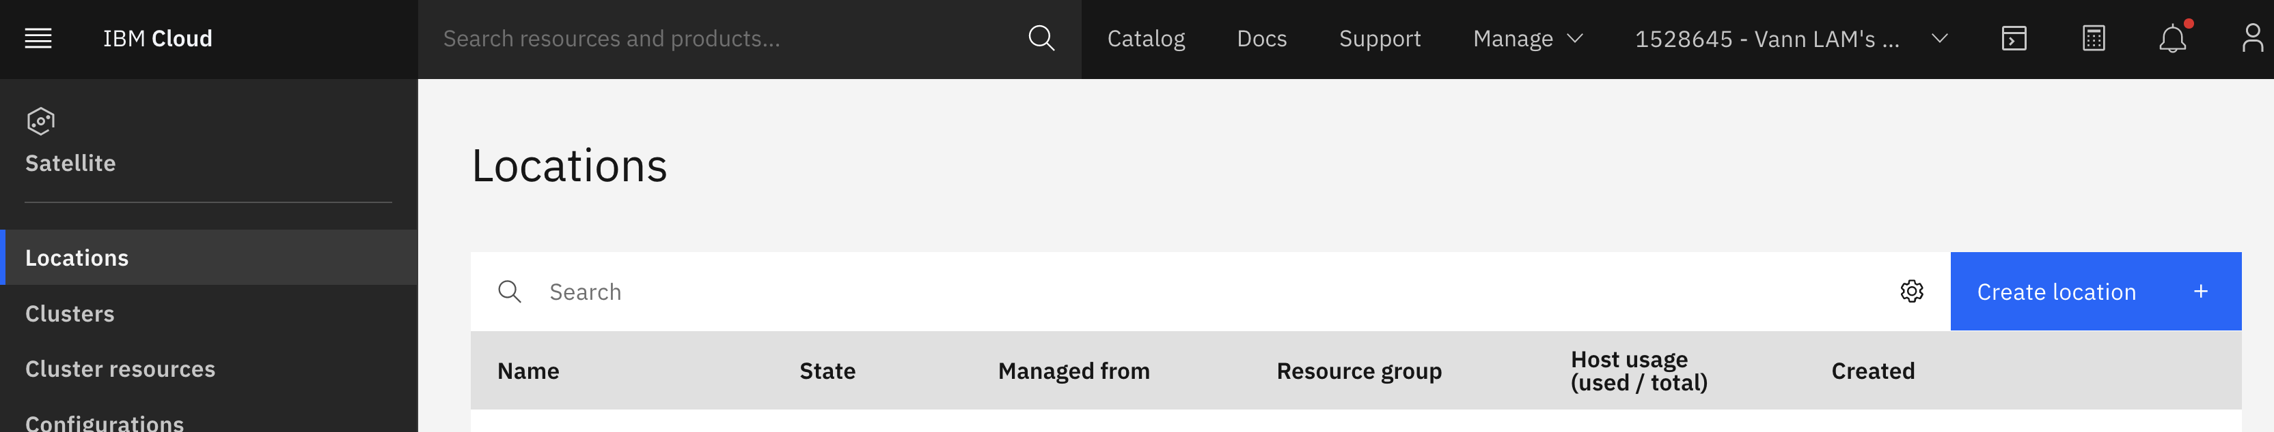
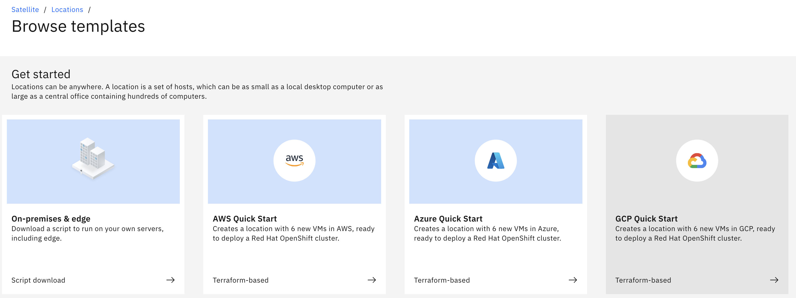
Create location on Azure
1
2

Slide 10
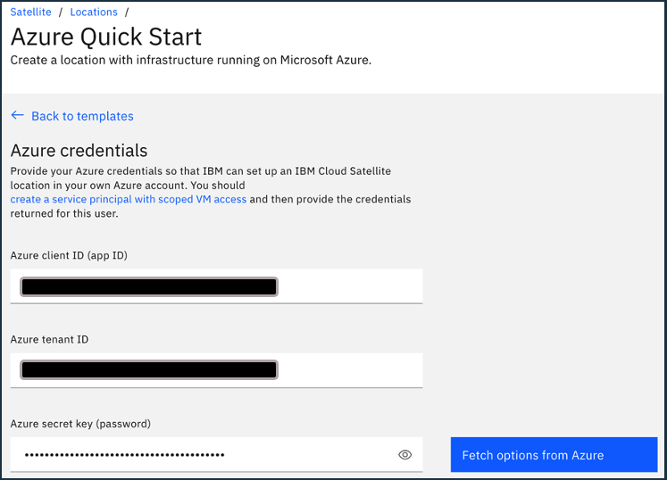
Enter Azure credentials
1
2

Slide 11
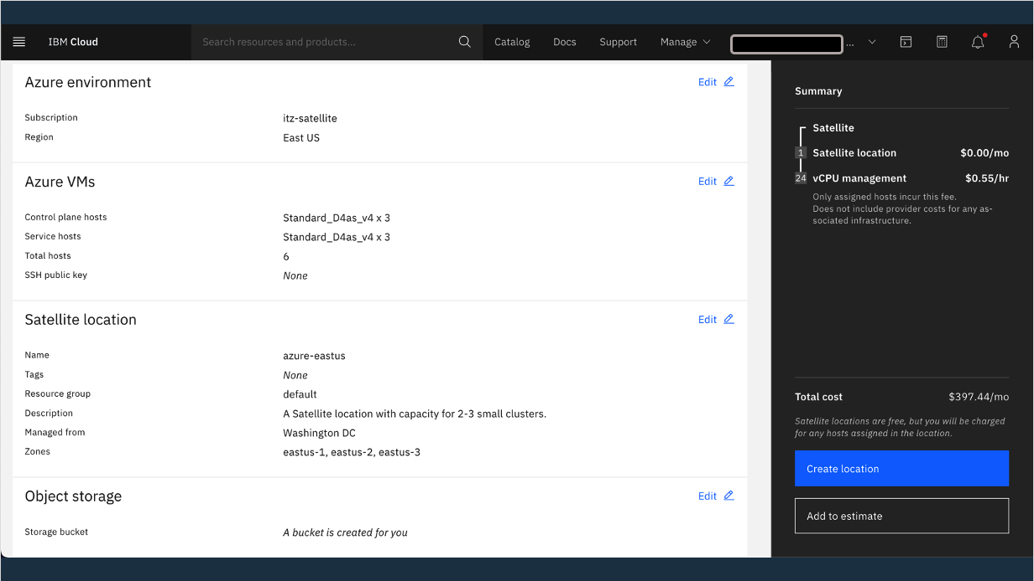
Choose your VMs profile and Satellite location name and “Managed from” site
1
2
3

Slide 12
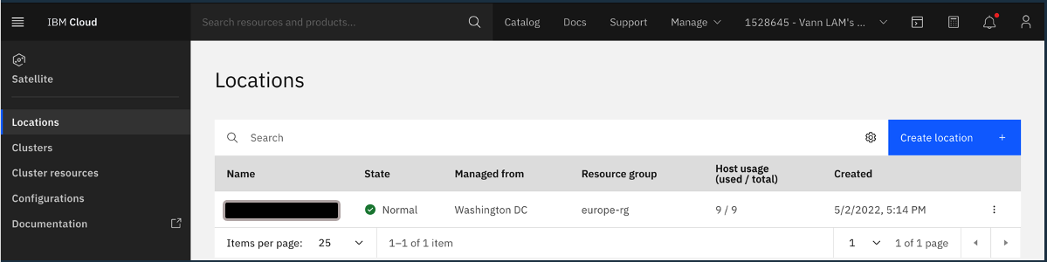
Back to location, location is available within 10 minutes
1

Slide 13
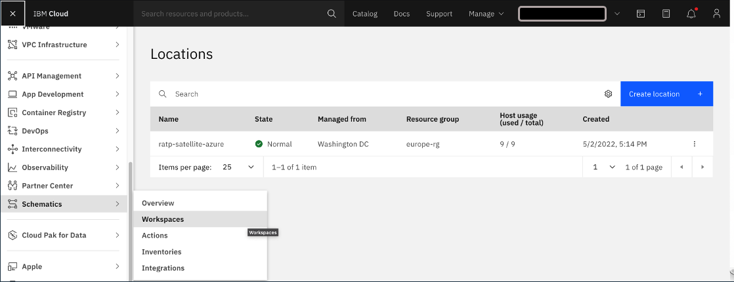
Terraform script within Schematics
1

Slide 14
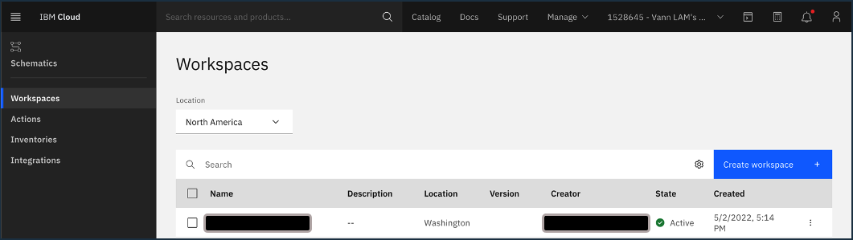
Terraform script within Schematics
1

Slide 15
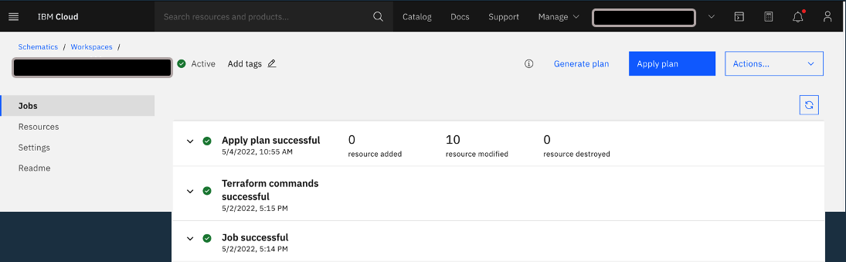
Terraform plan created and executed automatically

Slide 16
2. Deploy ROKS on a location on Azure

Slide 17
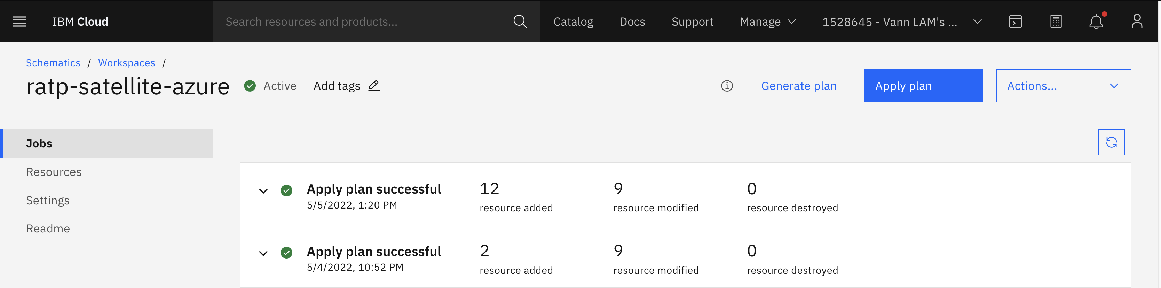
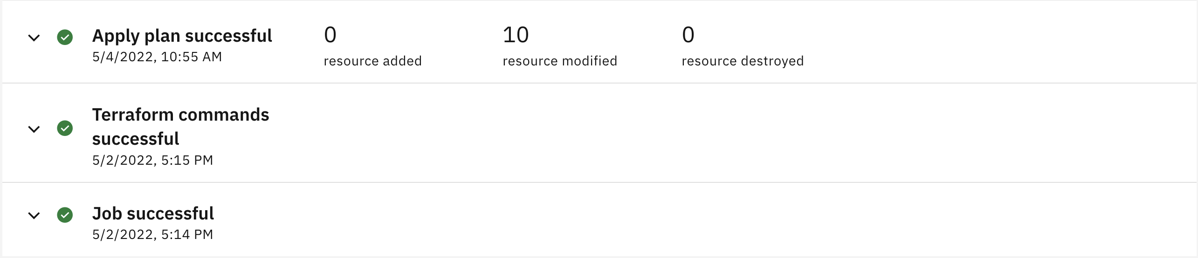

Slide 18
Terraform plan created and executed automatically

Slide 19
3. Create an image registry in ROKS using a COS bucket

Slide 20
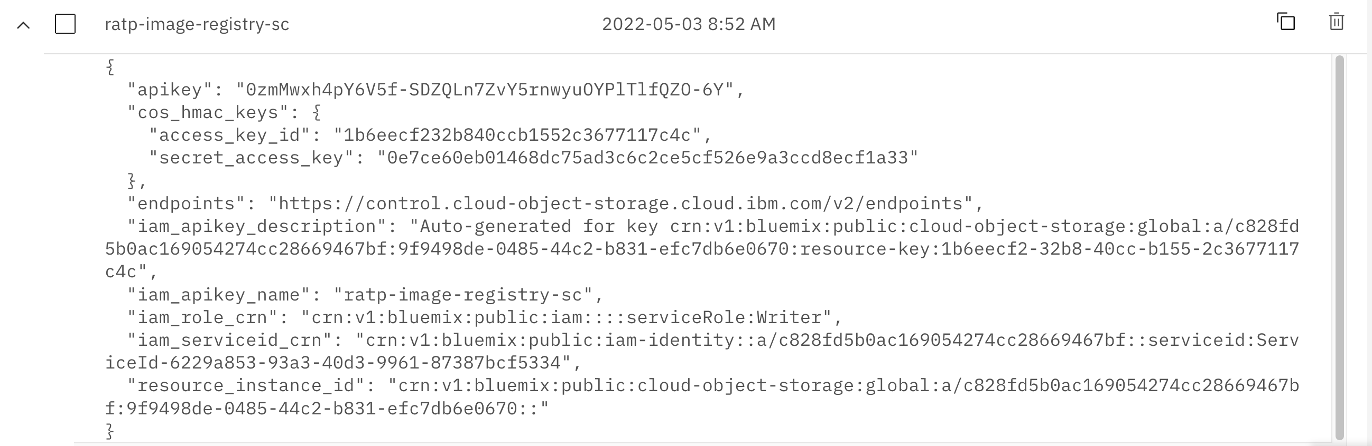

Slide 21
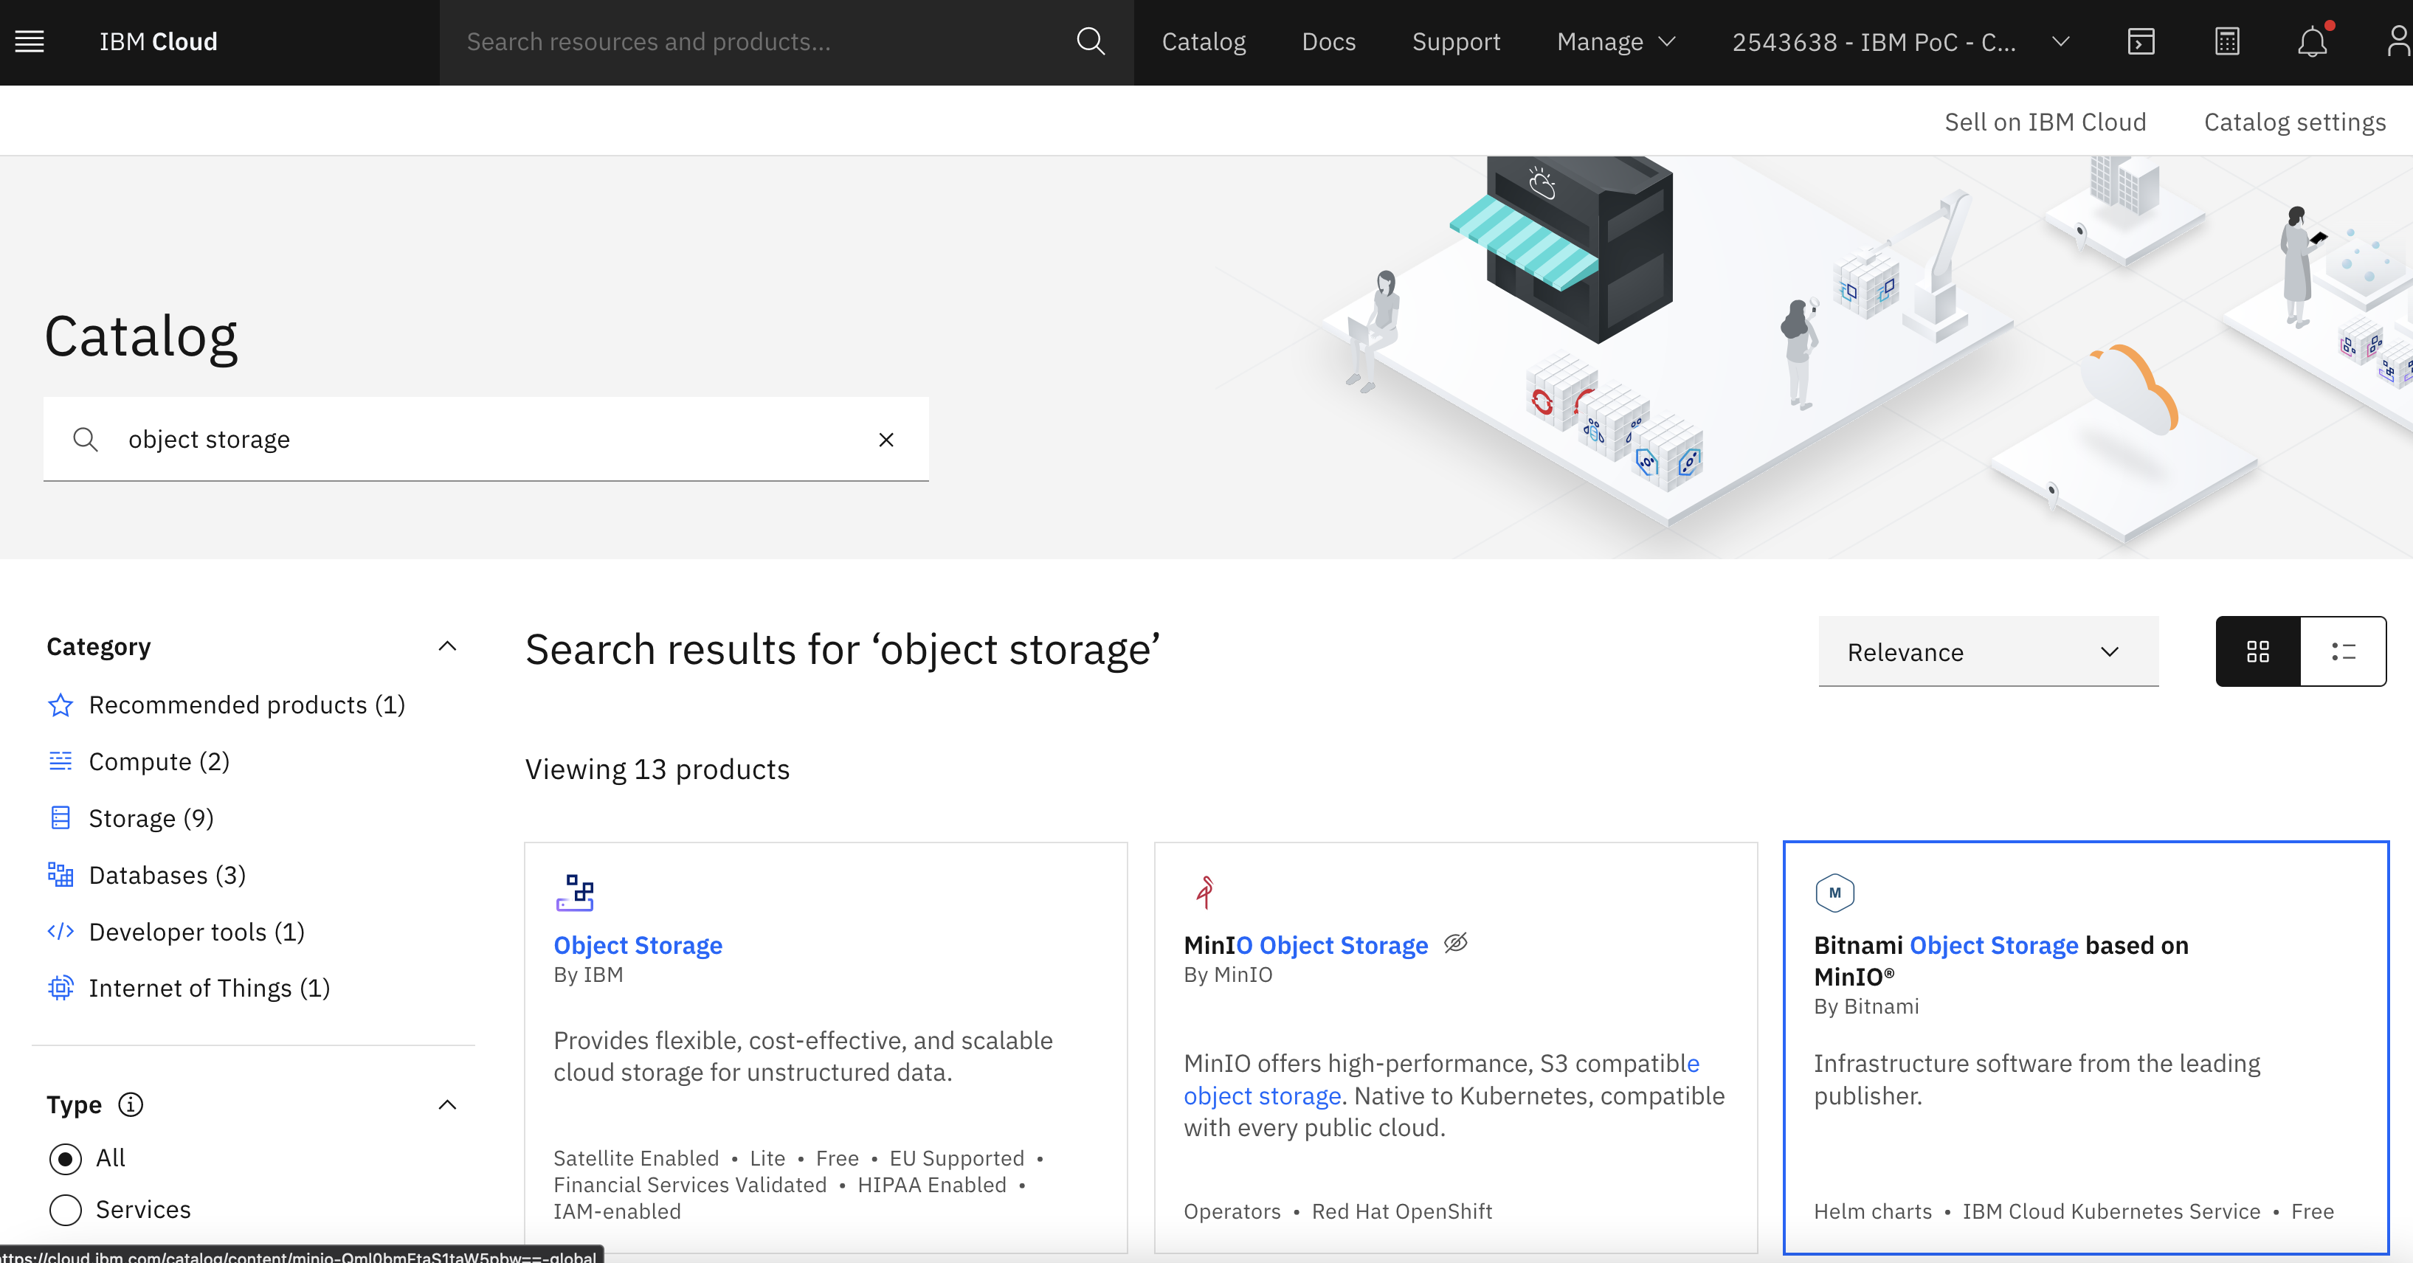
Create a Cloud object instance
1
2
3

Slide 22
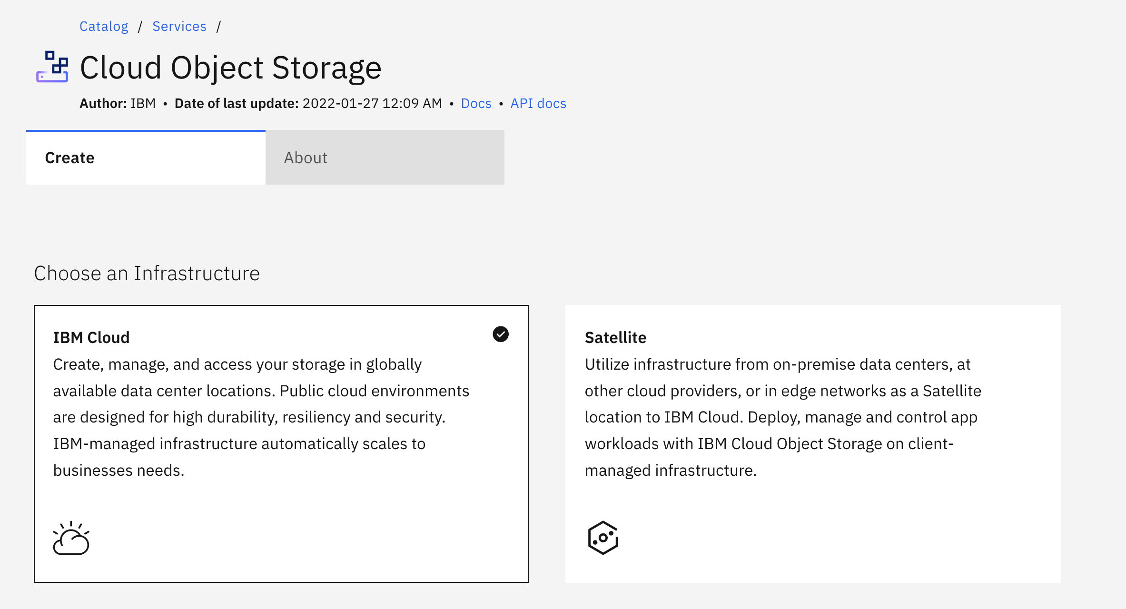
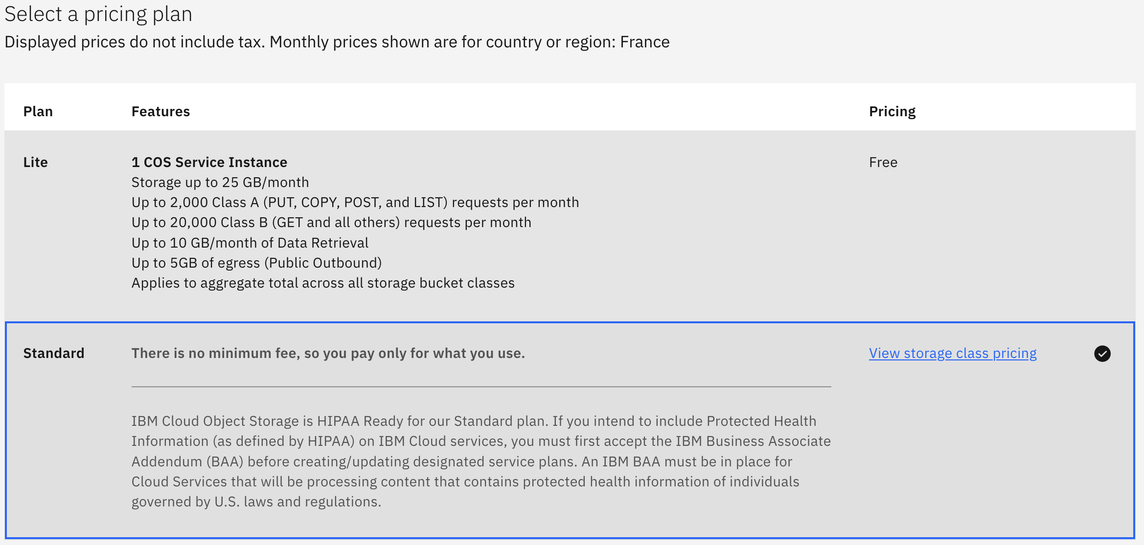
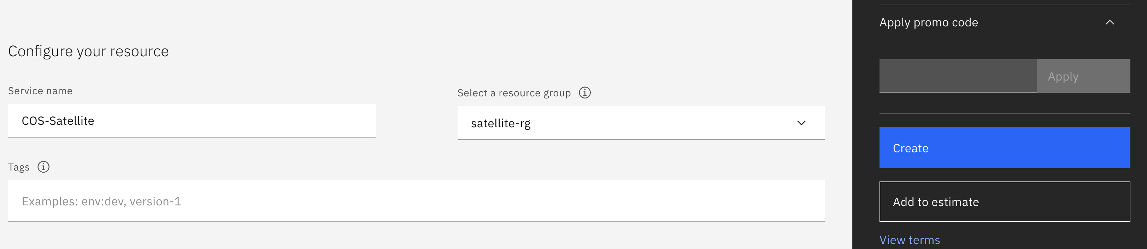
Create a Cloud object instance
1
2
3
4

Slide 23
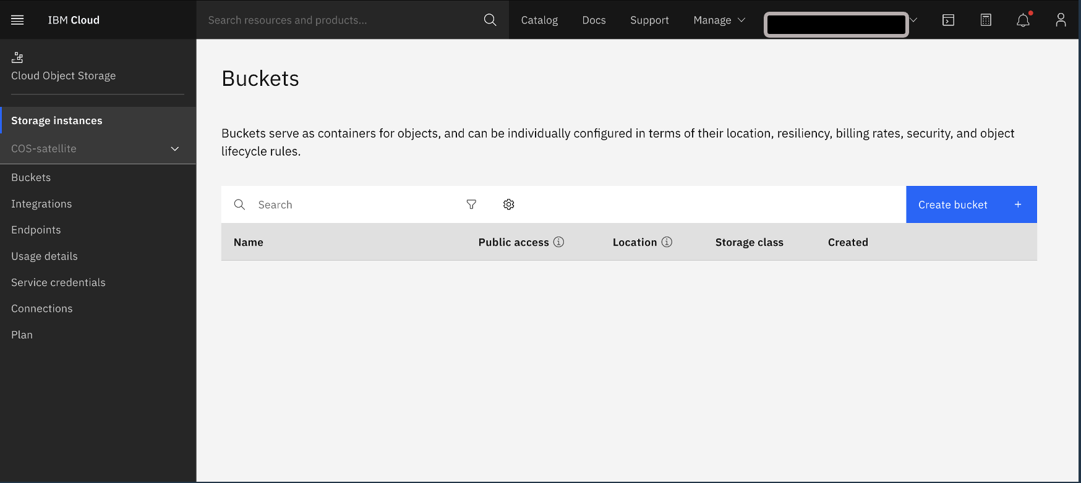
Create a COS bucket
1

Slide 24
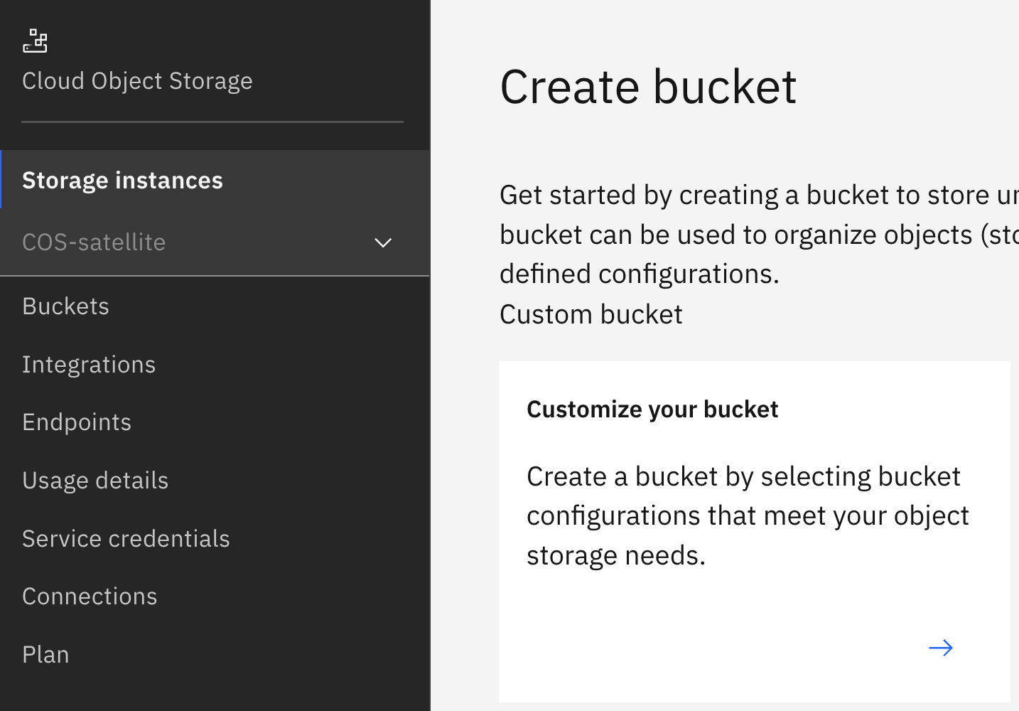
Create a COS bucket
1

Slide 25
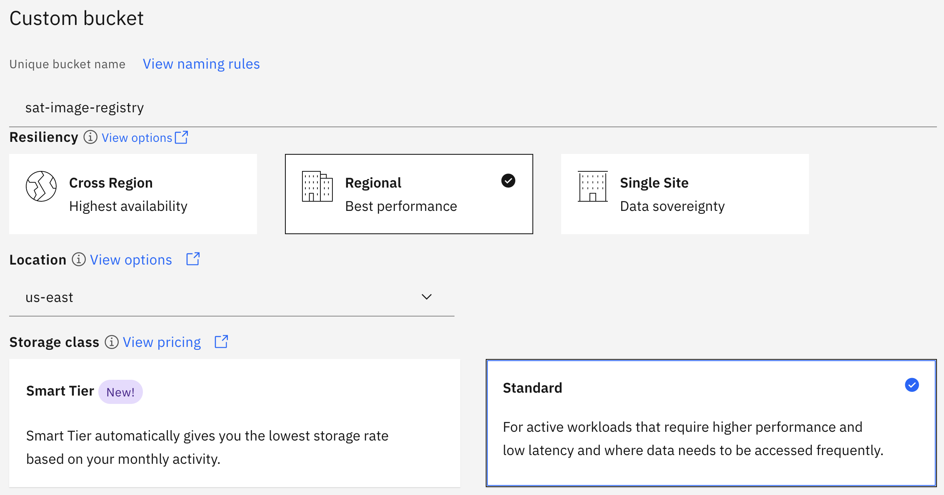
Create a COS bucket
1
2
3
4

Slide 26
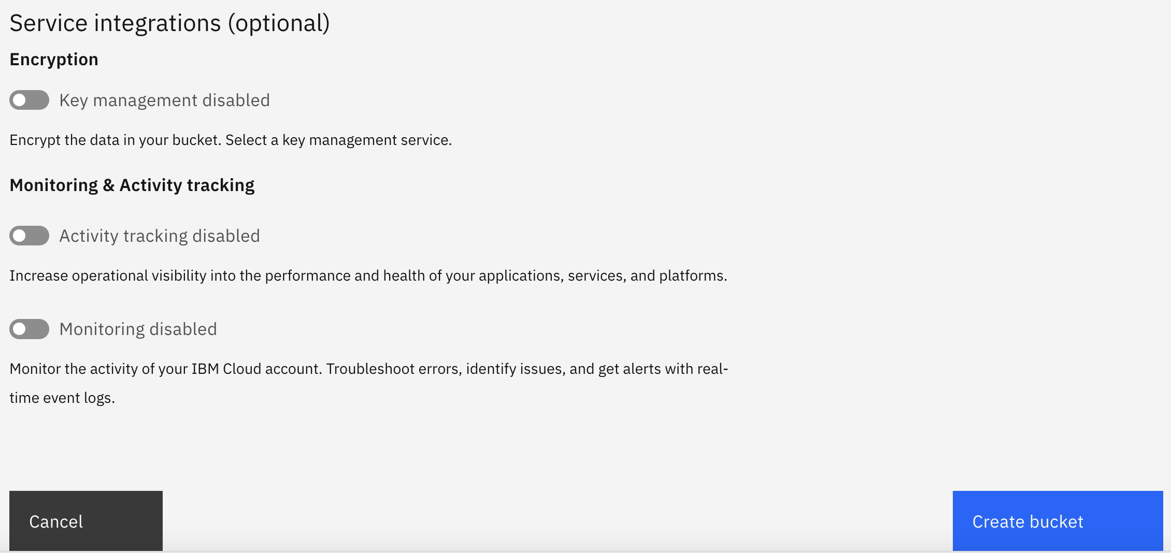
Create a COS bucket
1

Slide 27
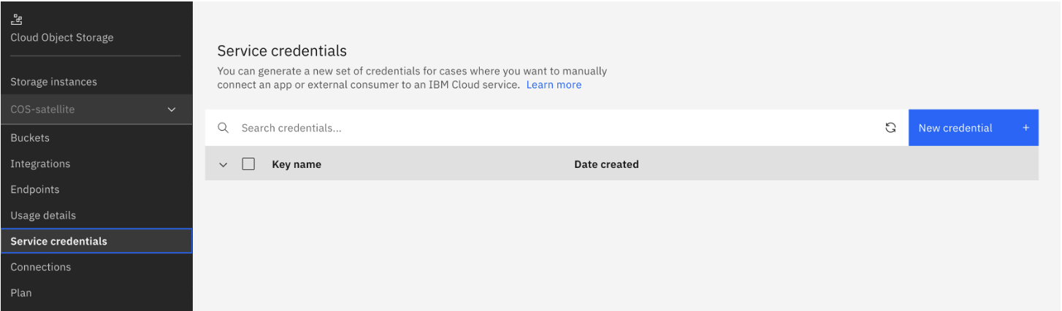
Create service credential for COS instance
2
1

Slide 28
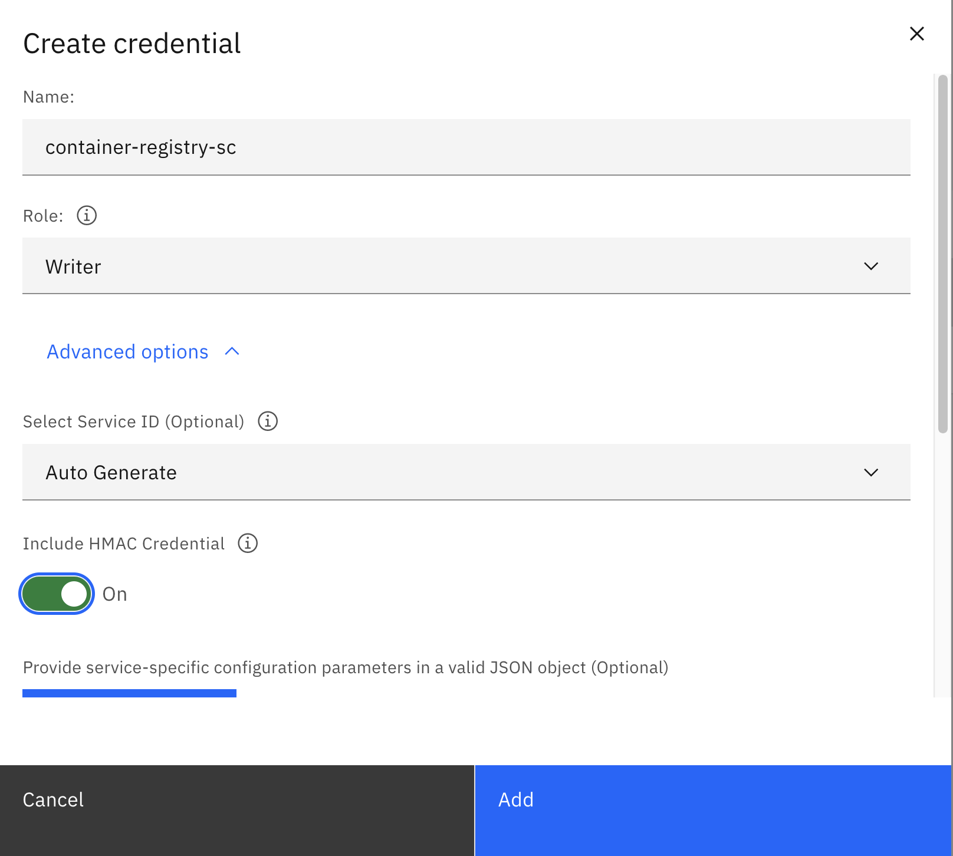
Create service credential for COS instance
1
2
3
4

Slide 29
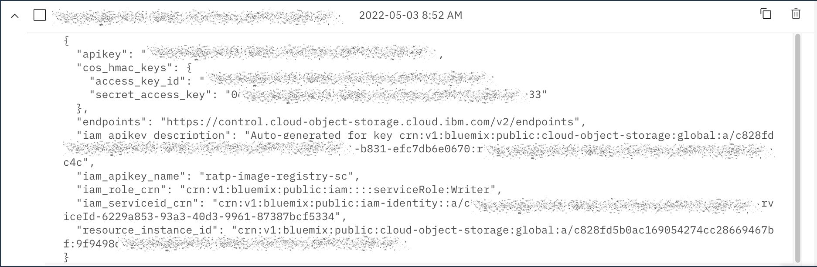
Cloud Object Storage HMAC credentials
1

Slide 30
4. Audit the Account Activities

Slide 31
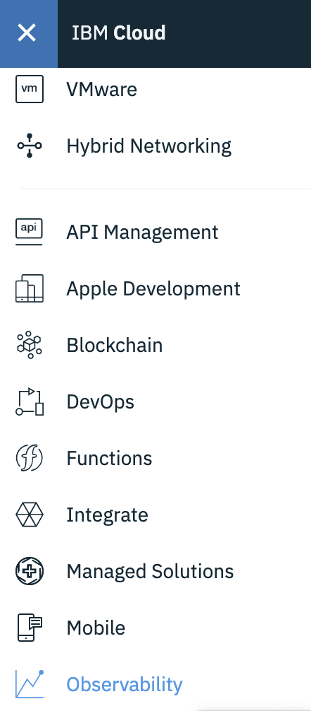
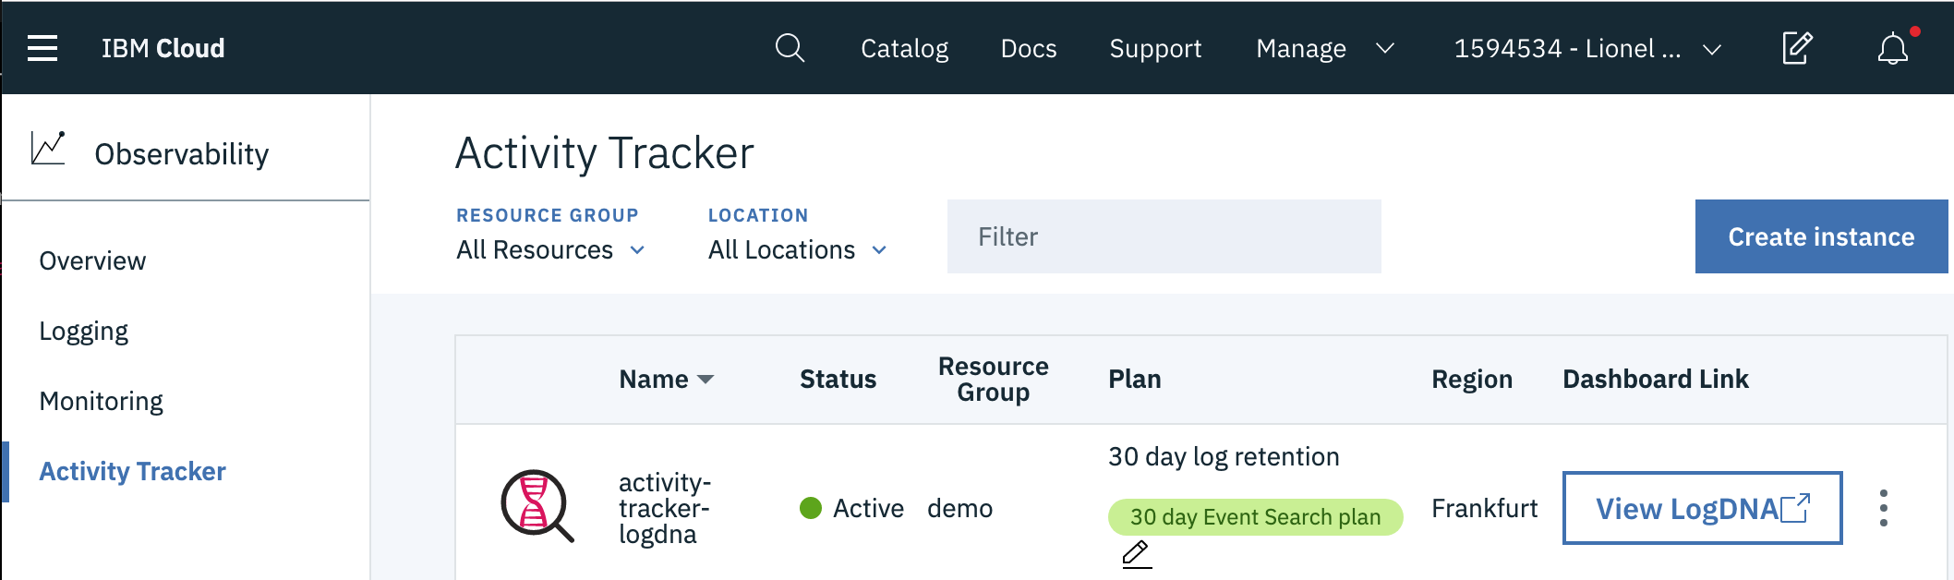
Track all the activities in the account before onboarding users
Create an instance of the service Activity Tracker
3
2
1
https://cloud.ibm.com/observe/activitytracker

Slide 32

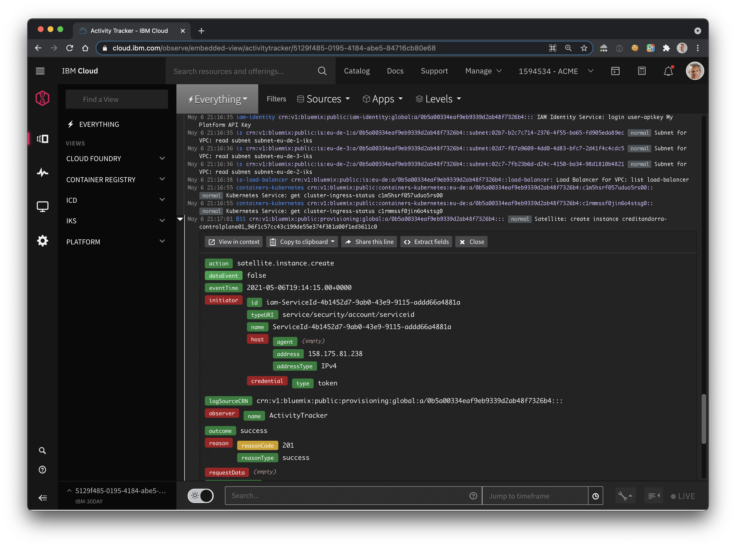
Audit you account activities with Activity Tracker
Audit the activity of
your IBM Cloud account such as new Resources Creation.
Investigate abnormal activity and critical actions.
Be alerted on actions as they happen.
Comply with Cloud Auditing Data Federation (CADF) standard
Retain your events for 7, 14, or 30 days
https://cloud.ibm.com/observe/activitytracker
Notes:
who did what? When?

Slide 33
5. Invite New Users

Slide 34
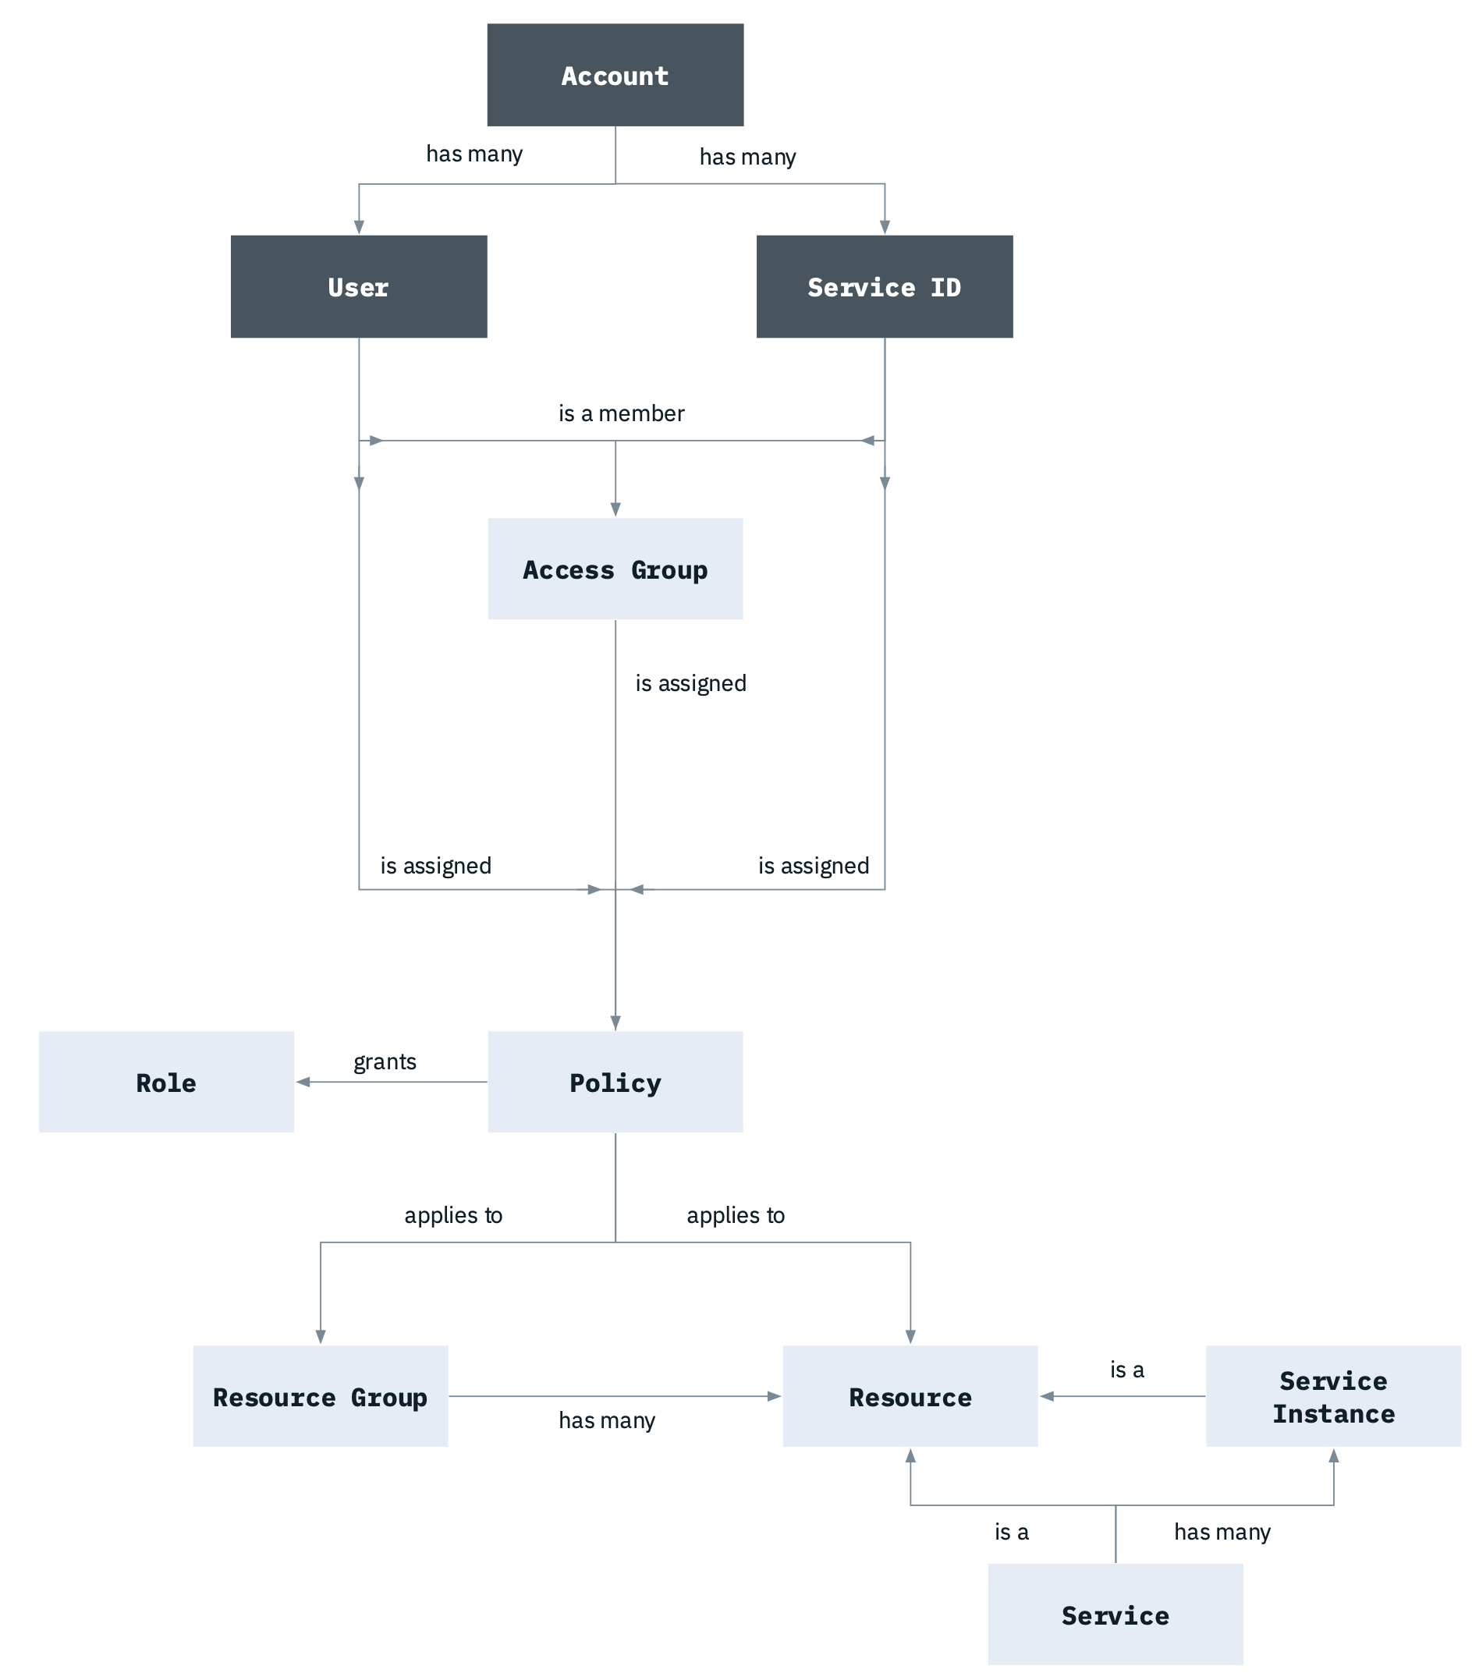
IAM – Identification Access Manager
Enable to securely authenticate users for platform services and control access to resources consistently across IBM Cloud
User management
Fine-grained access control
Access groups for streamlined access
API keys for user authentication
Service IDs
Multifactor authentication
Service to service authorizations
https://cloud.ibm.com/docs/account?topic=account-iamoverview

Slide 35
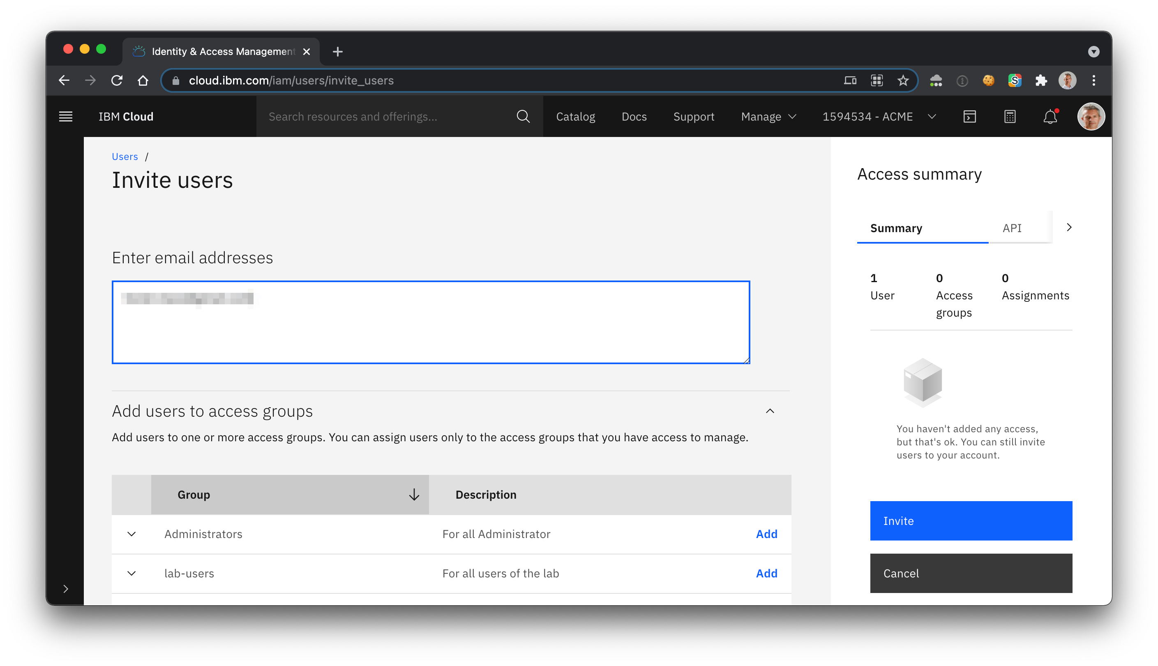
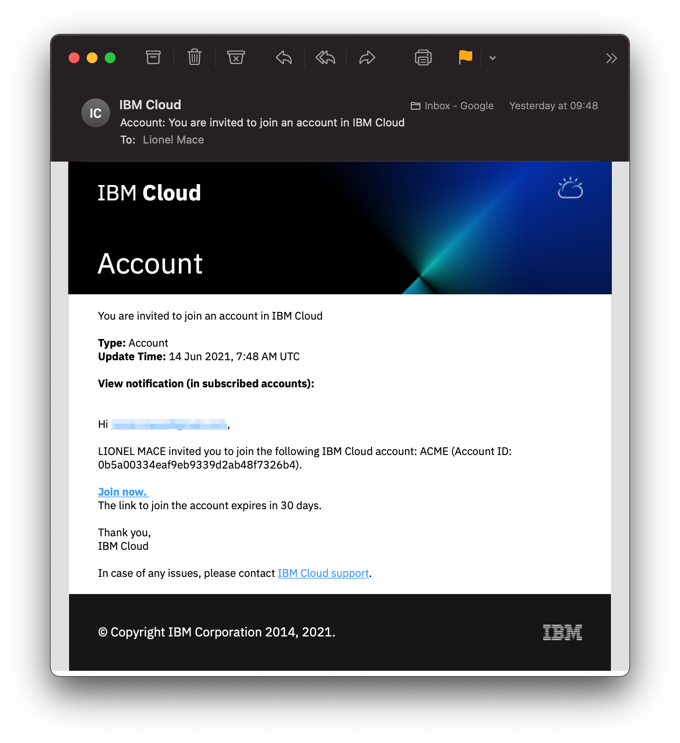
Invited users must accept invitations to each invited account
1
2
3
https://cloud.ibm.com/iam/users/invite_users

Slide 36
6. Control the Cloud Services Consumption

Slide 37
Provisioning scenario: Pulling it all together
Notes:
Diagram Source: https://cloud.ibm.com/docs/third-party?topic=third-party-how-it-works

Slide 38
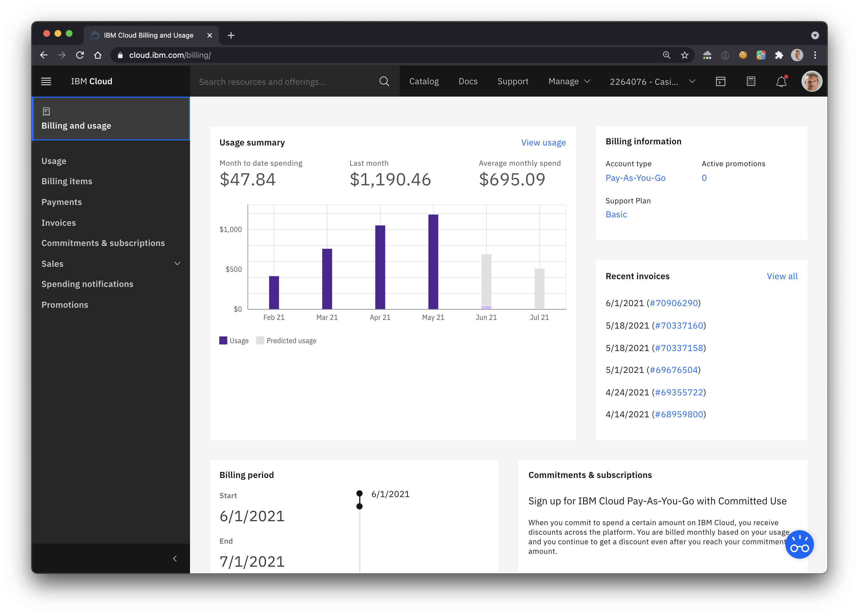
Billing and Usage
https://cloud.ibm.com/billing/

Slide 39
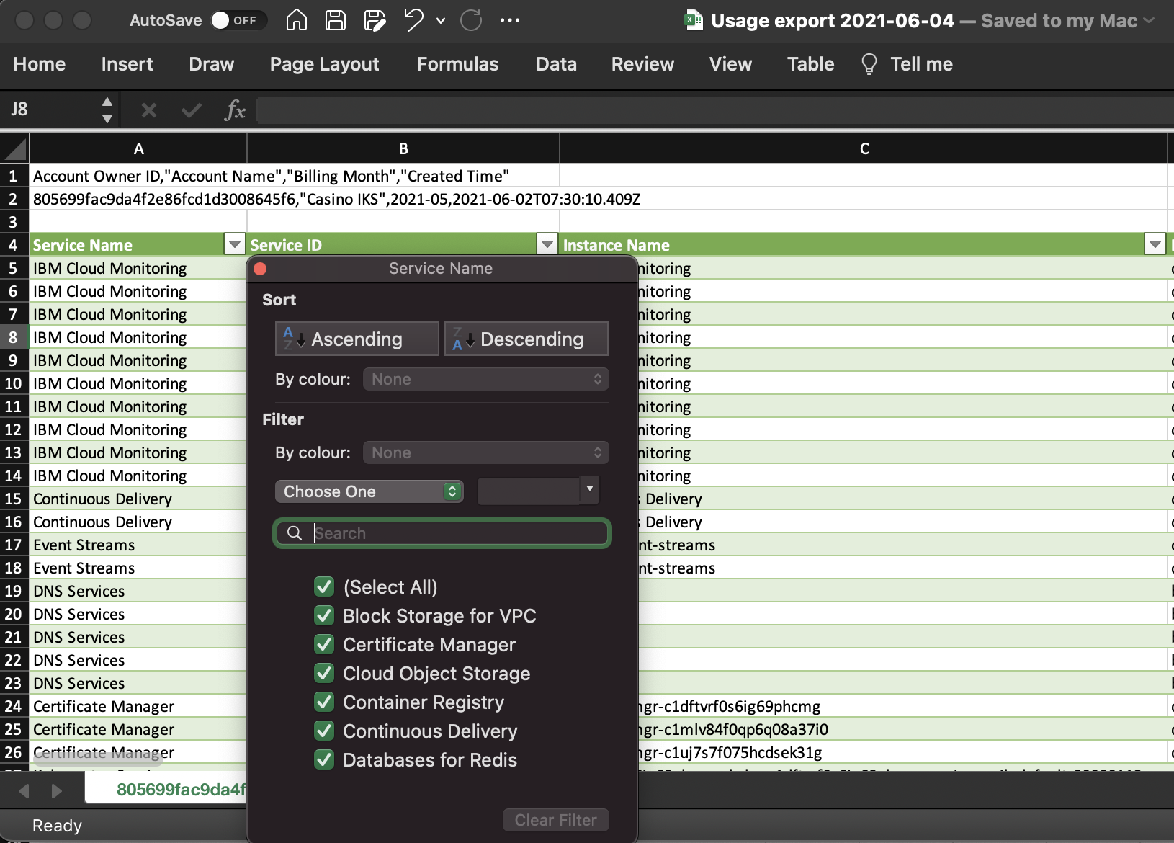
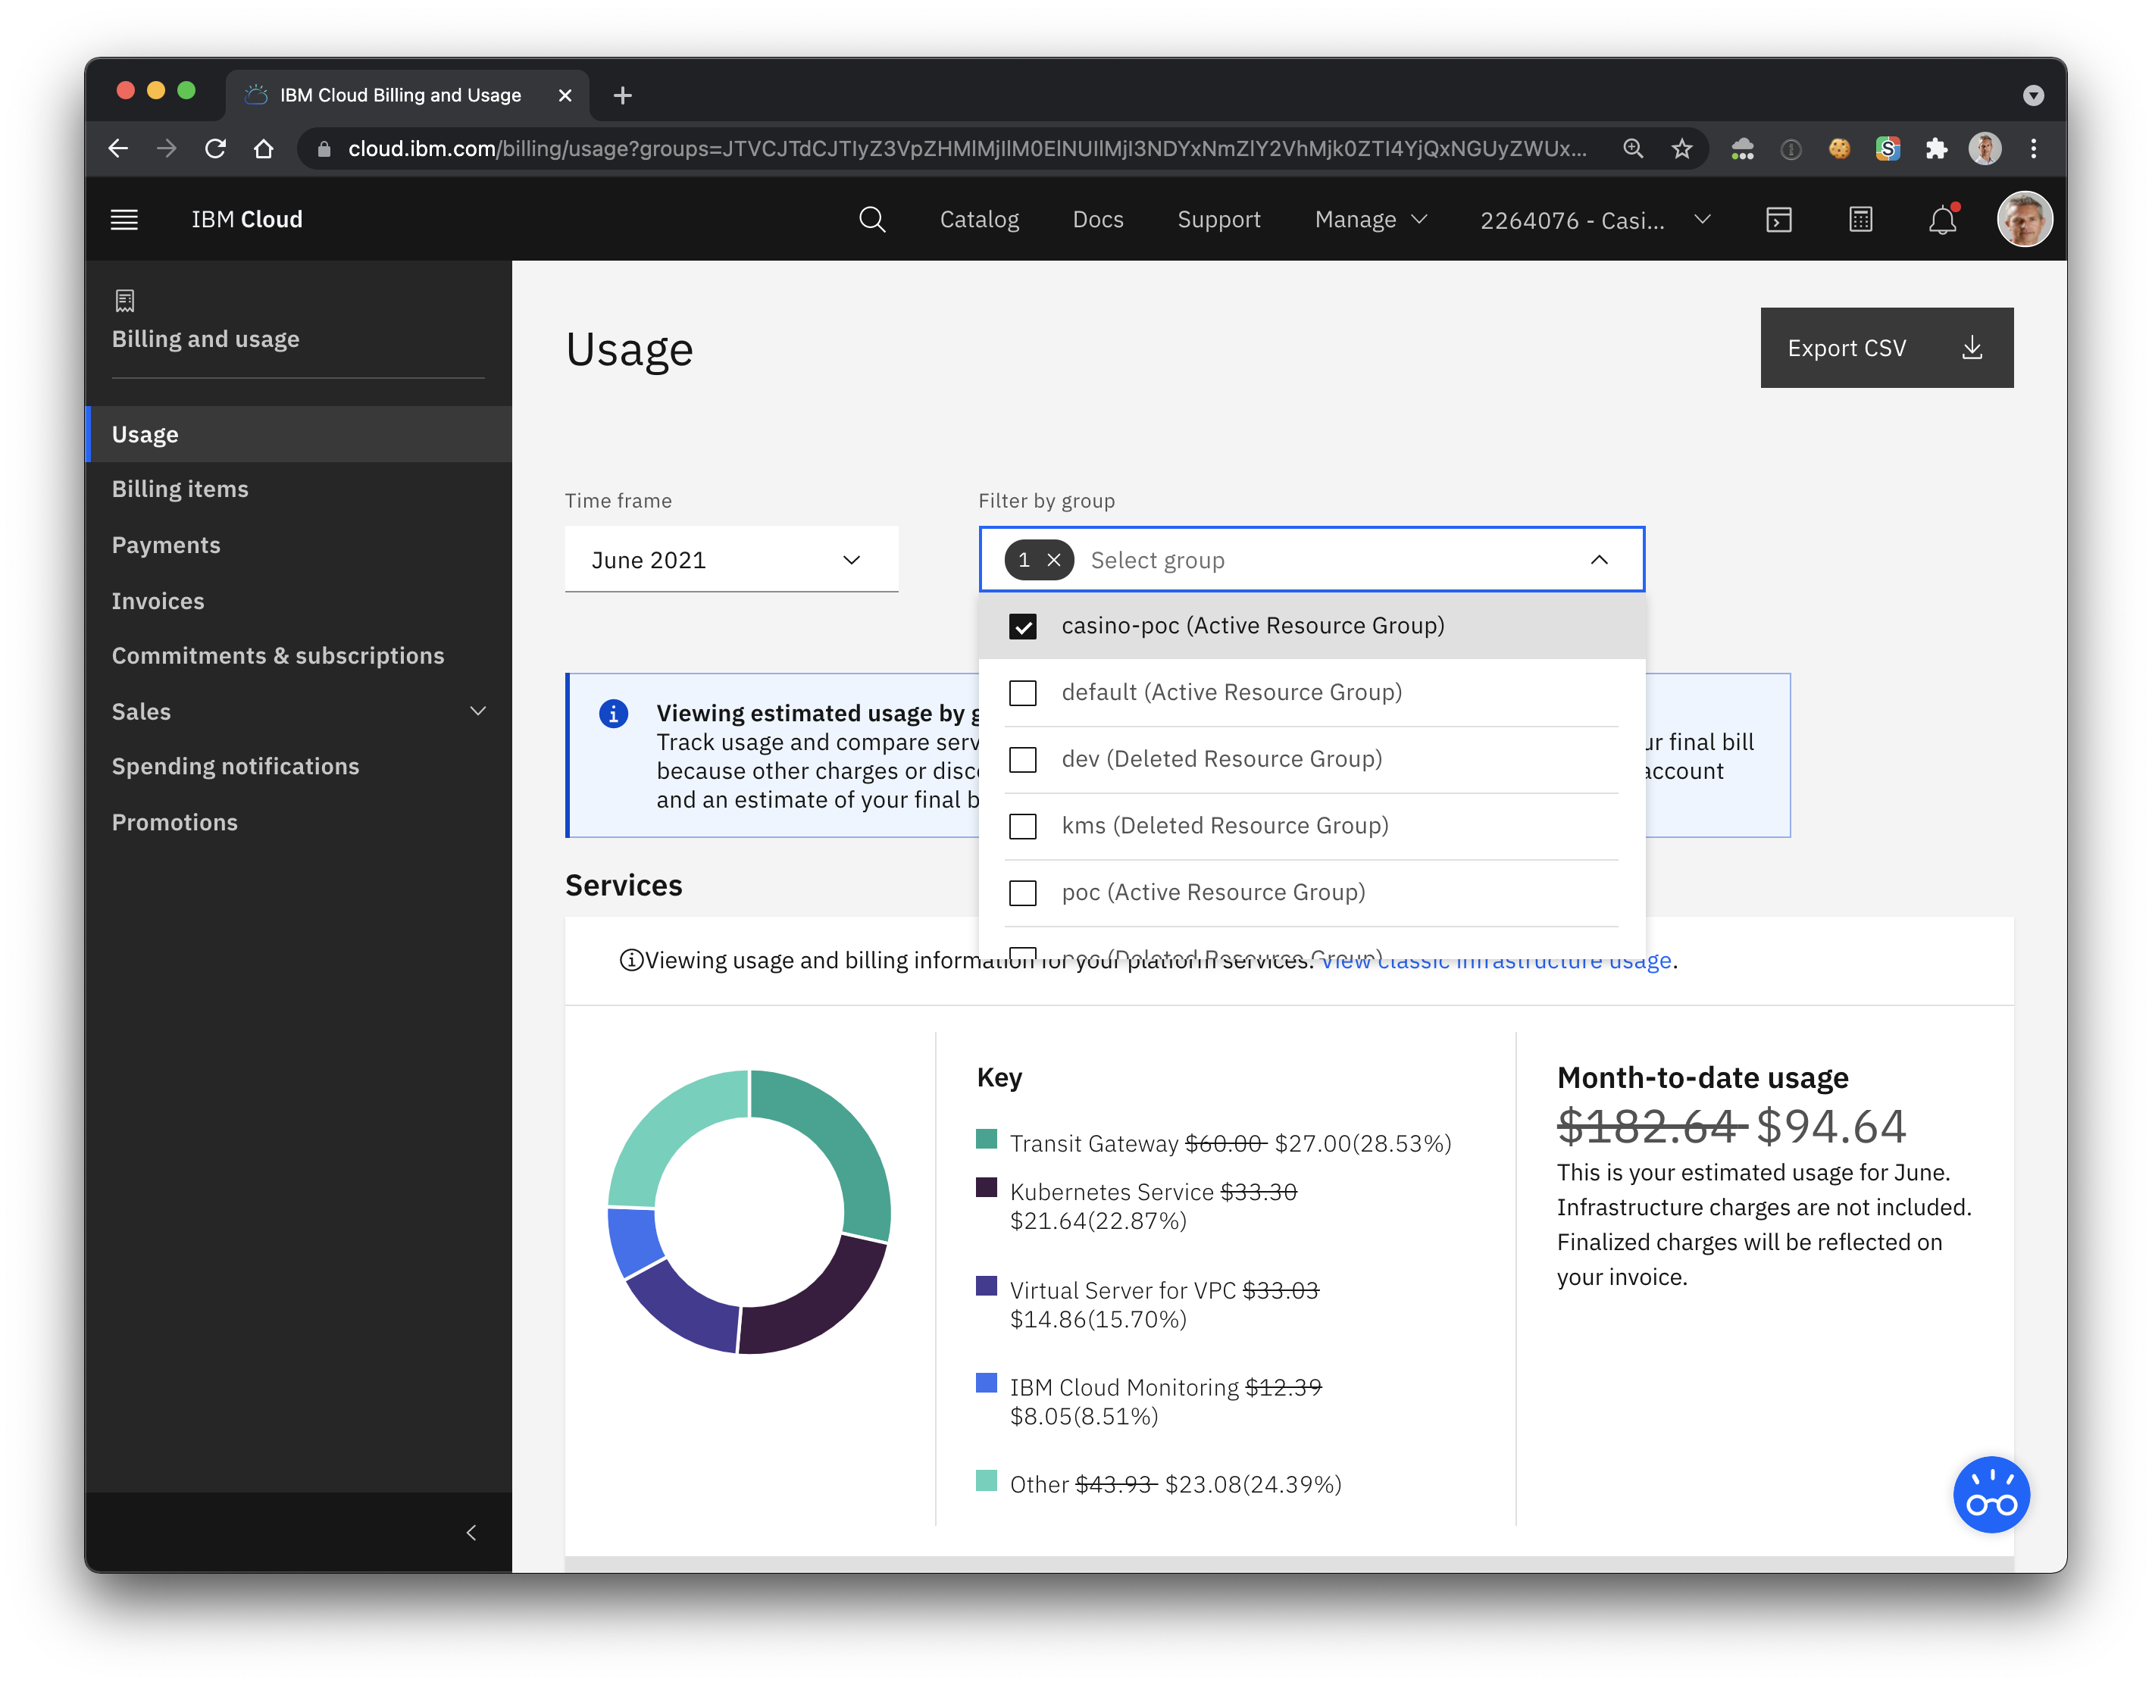
Usage Dashboard and Export
Filter per
Account
Resource Group
Export CSV
Global
Instances
https://cloud.ibm.com/billing/

Slide 40
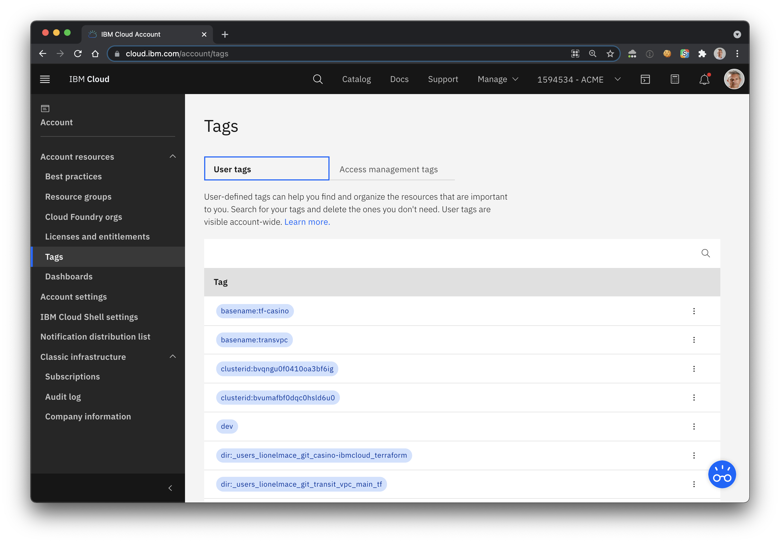
Tag Management

Slide 41
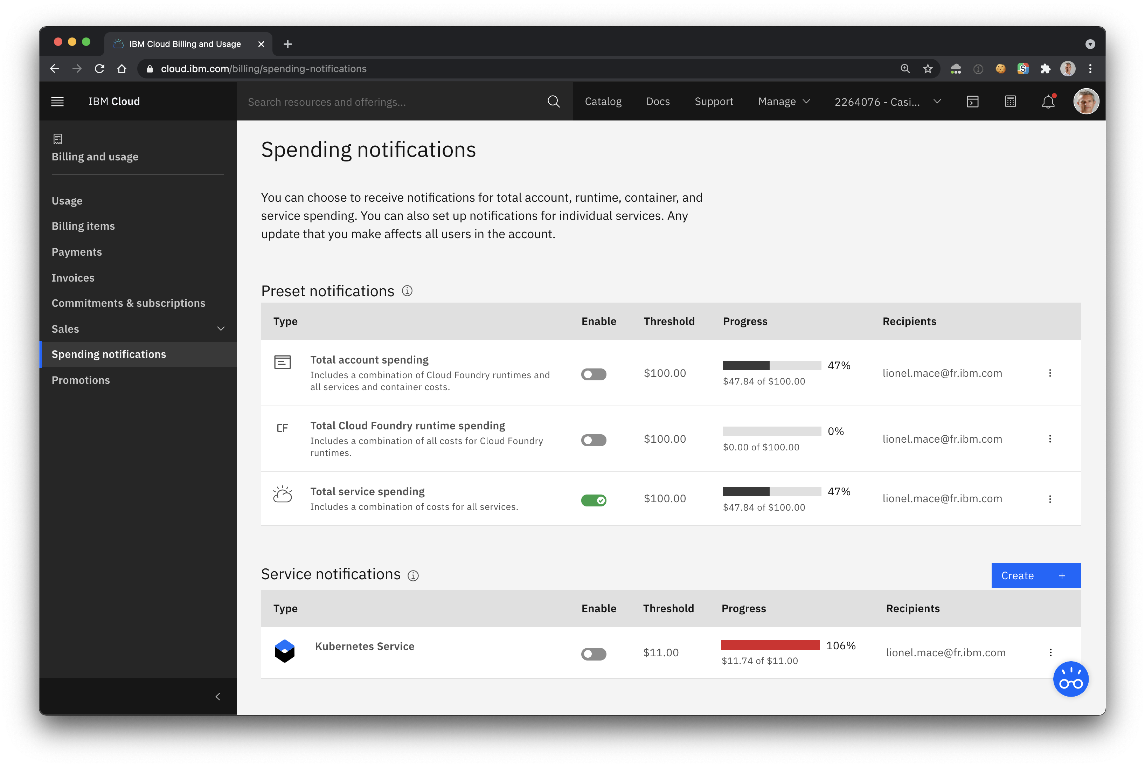
Set Spending Notifications to get email alerts
Alert per Total account
Alert per service
1
2

Slide 42
7. Track Platform Announcements and Status

Slide 43
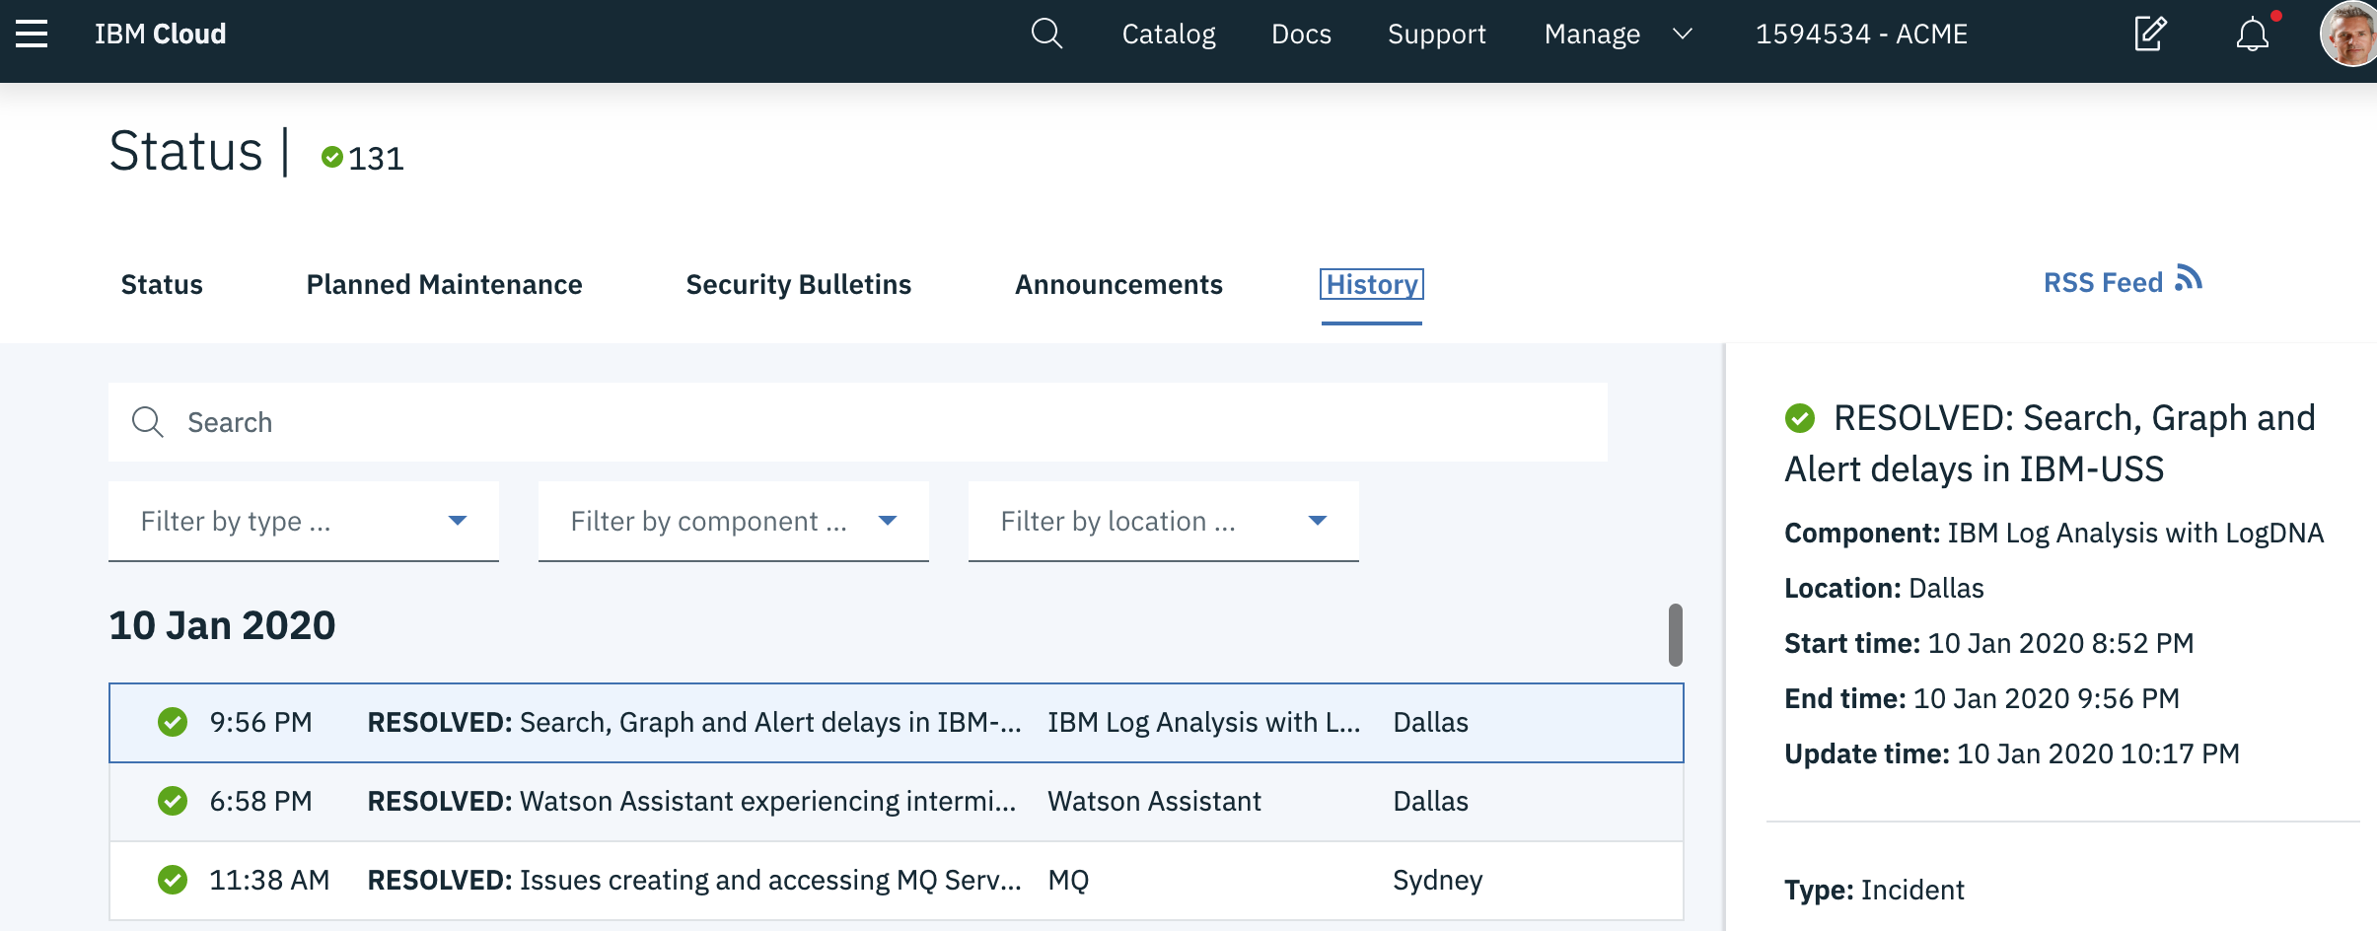
Planned Maintenance, Security Bulletins, Status
https://cloud.ibm.com/status?selected=status

Slide 44
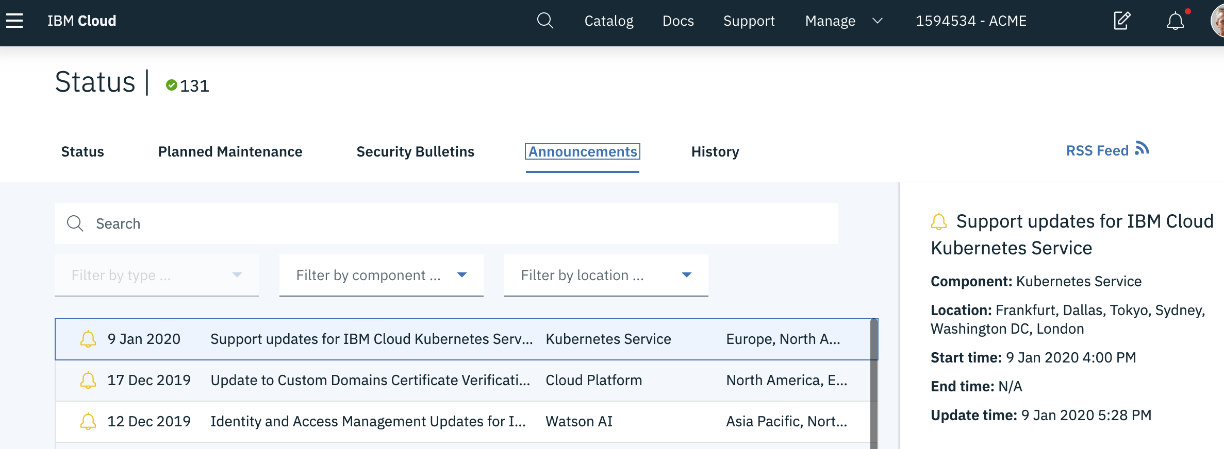
Keep track of Announcements
https://www.ibm.com/cloud/blog/announcements

Slide 45
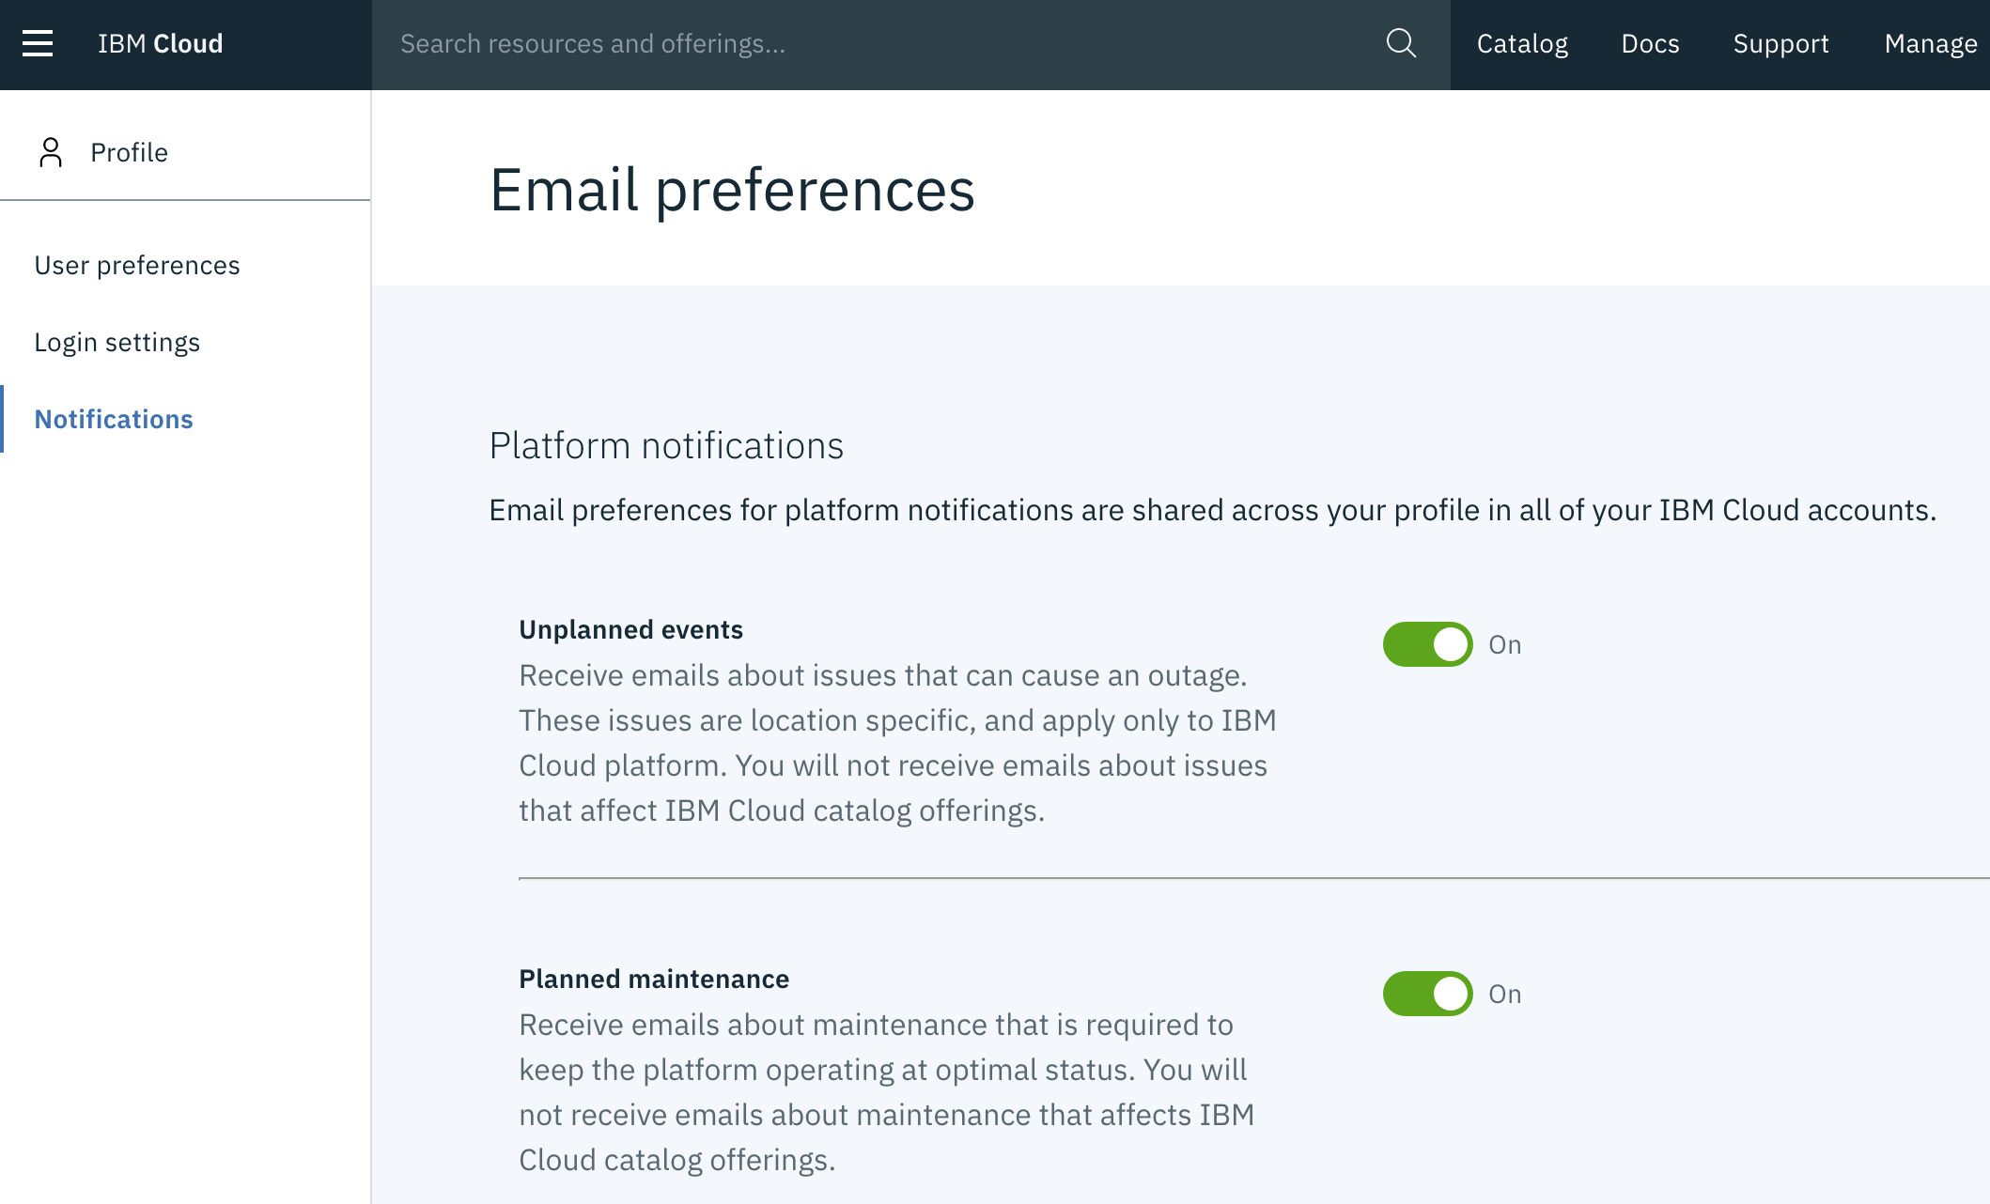
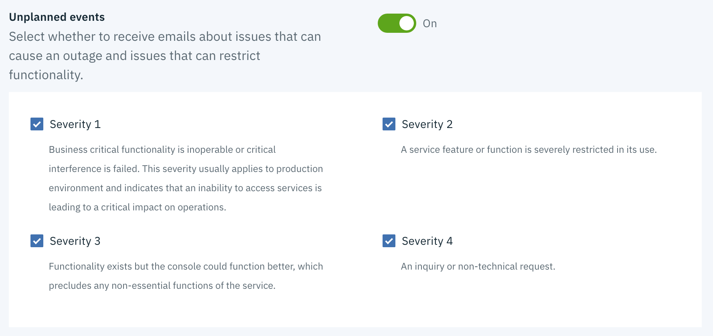
Check your email preferences
https://cloud.ibm.com/user/notifications

Slide 46
8. Contact to Customer Support

Slide 47
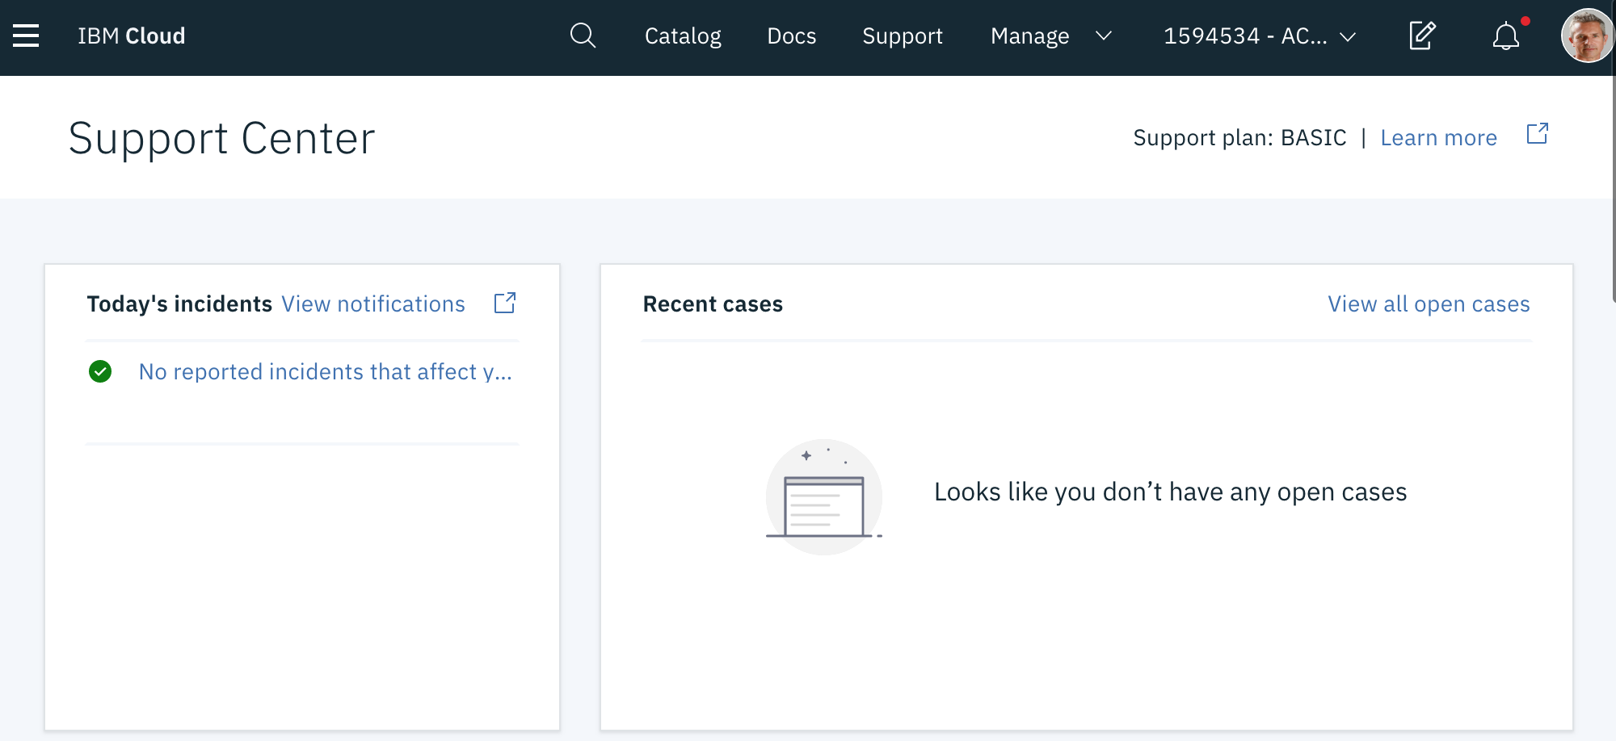
Support Case
1
2
https://cloud.ibm.com/unifiedsupport/supportcenter

Slide 48
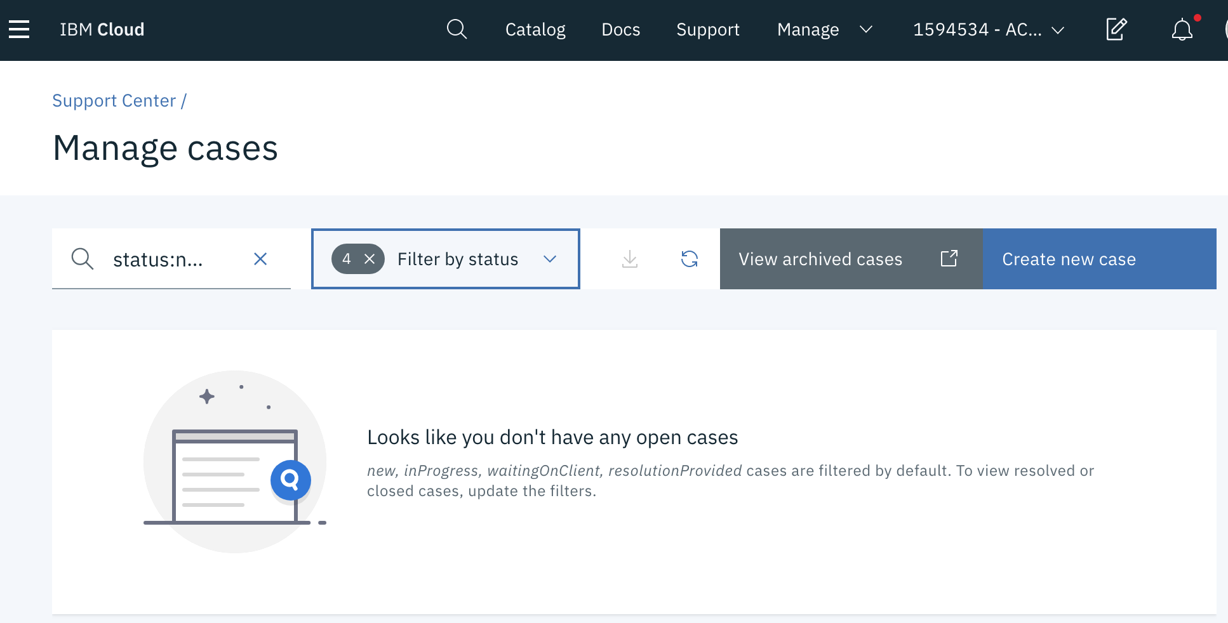
Create a New Case
1

Slide 49
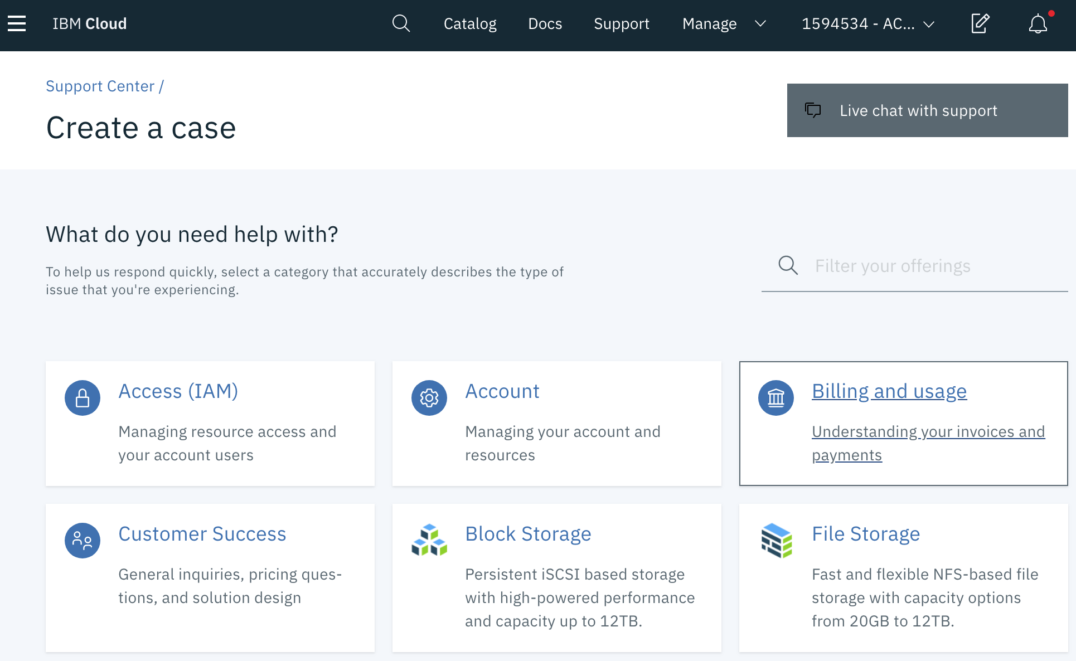
Select the type of case

Slide 50
9. Enable VRF Virtual Routing and Forwarding (VRF)

Slide 51
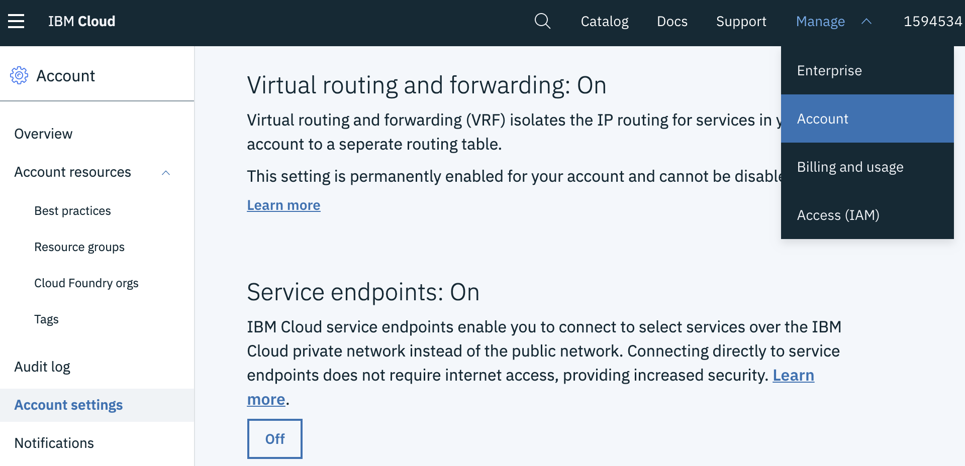
Make sure VRF is turned on to user private Service Endpoint
3
1
4
2
https://cloud.ibm.com/account/settings

Slide 52
10. Connect with IBM Cloud CLI Command Line

Slide 53
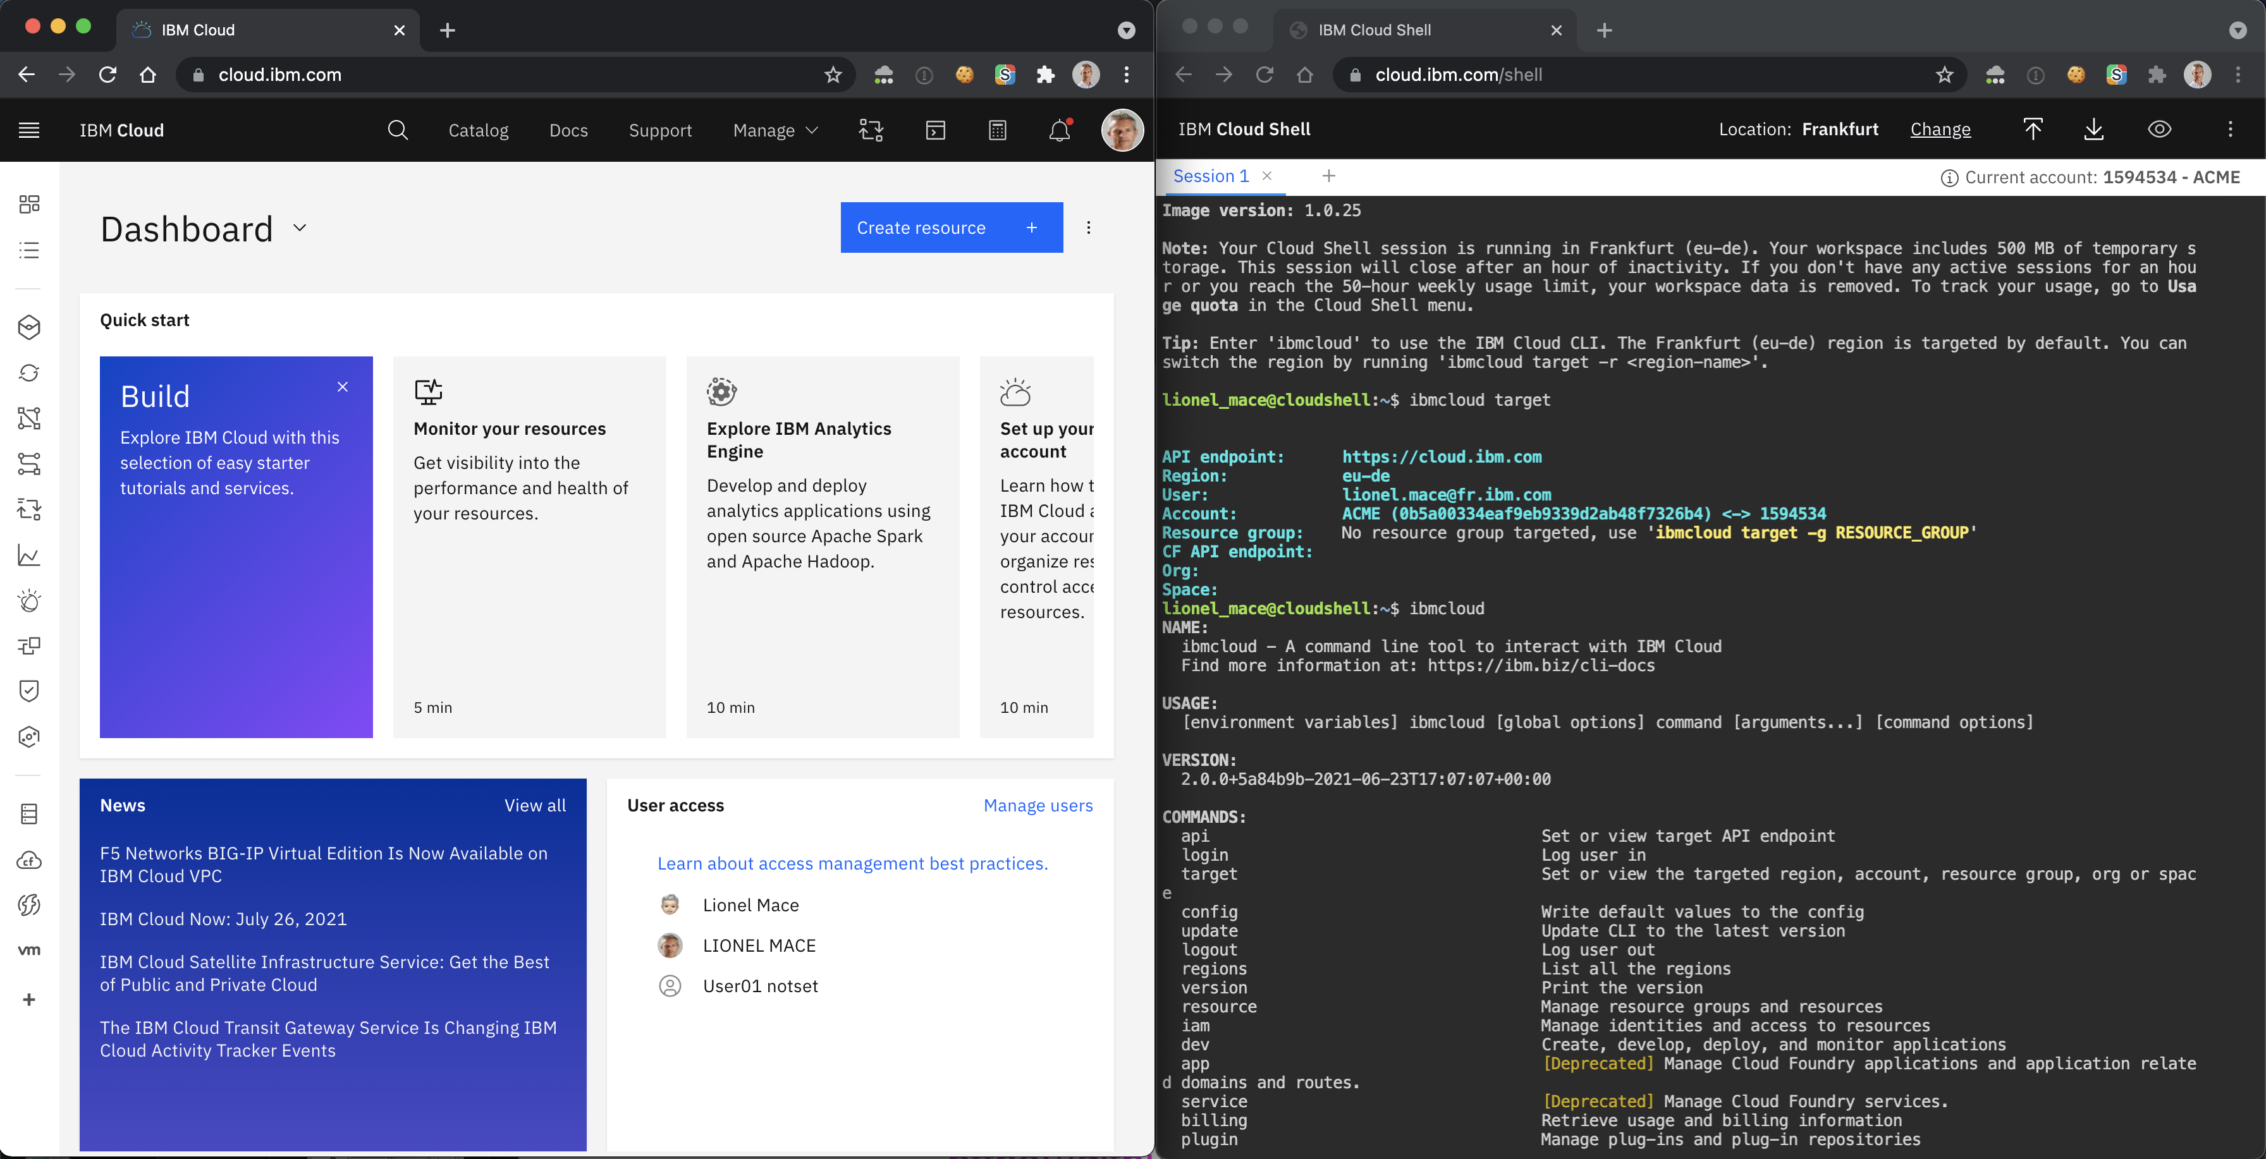
Use the hosted Cloud Shell
https://cloud.ibm.com/shell

Slide 54
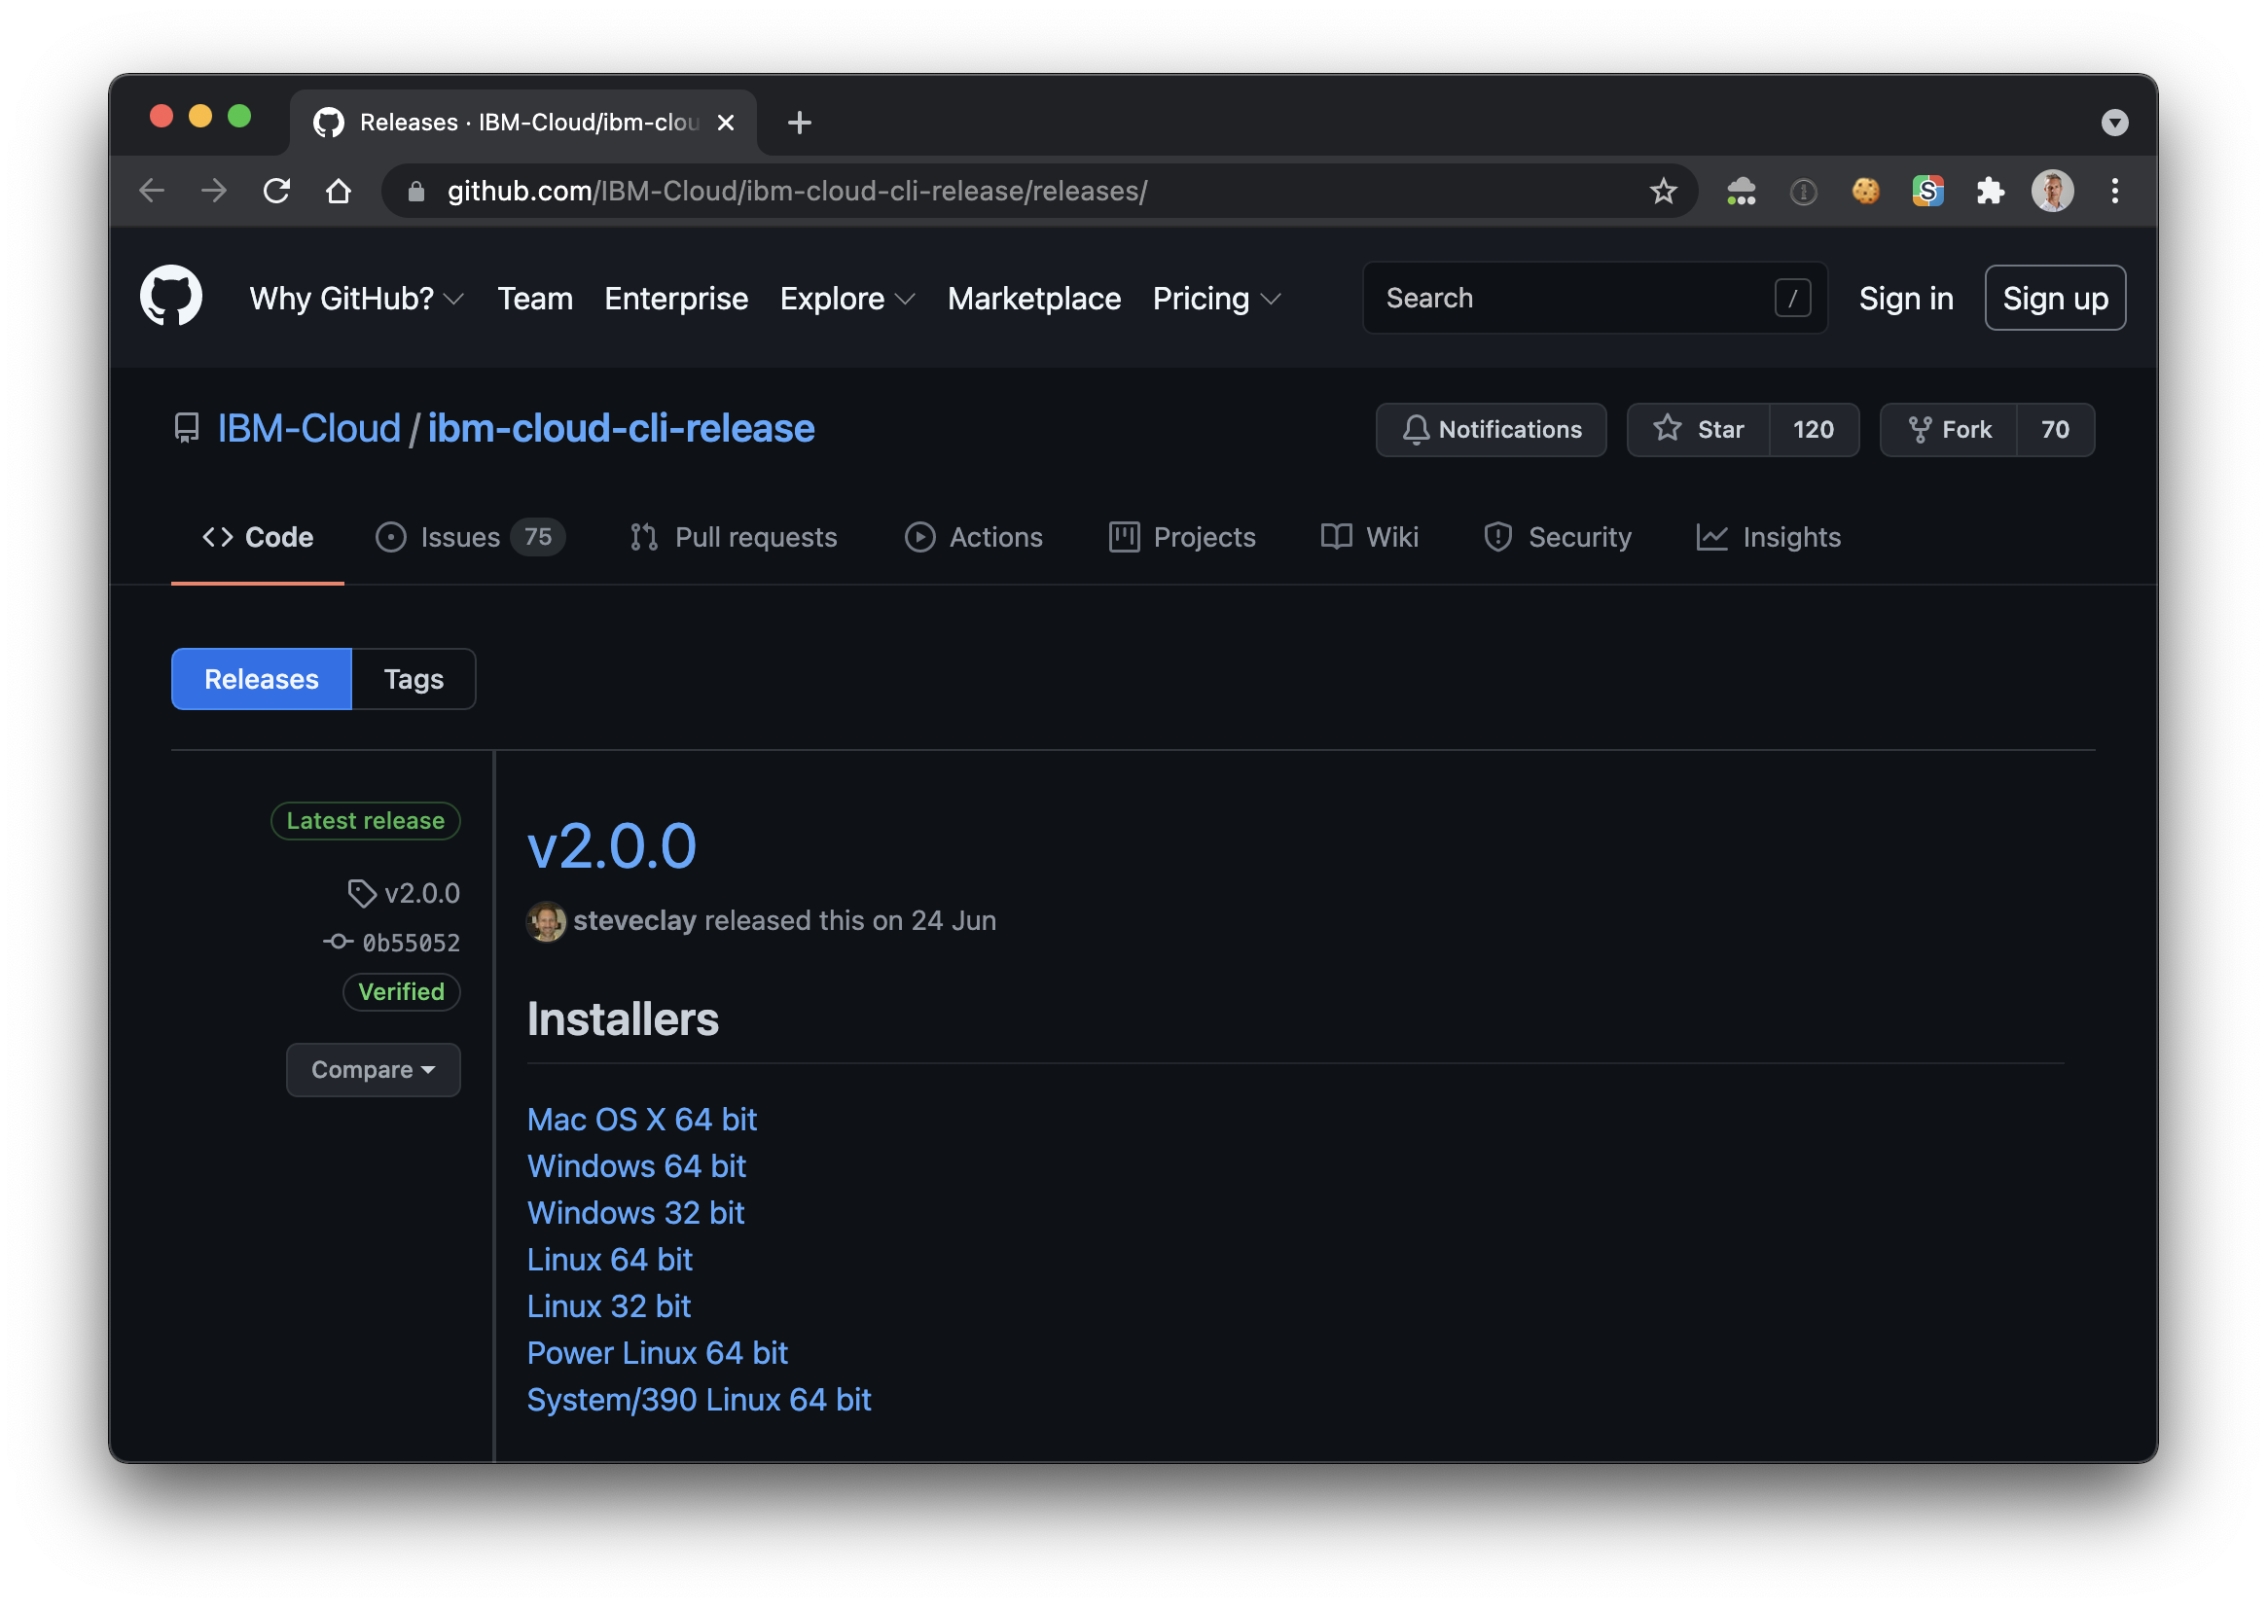
Install the IBM Cloud CLI
https://github.com/IBM-Cloud/ibm-cloud-cli-release/releases/

Slide 55



Main Command
Lines
ibmcloud login
IBM Cloud Account
ibmcloud target –r eu-de
Region
CONTAINER REGISTRY (CR)
Namespace
ibmcloud cr images
docker push <my-image>
ibmcloud target –g <rg-name>
RESOURCE GROUP (RG)
ibmcloud ks
Kubernetes
Service (KS)
Cluster
Logging and Monitoring data
kubectl
Namespace
DOCKER
REGISTRY
ibmcloud resource
CLOUDANT
Developer
ibmcloud target –o org –s space
Cloud Foundry (CF) Organization
Cloud Foundry Space
ibmcloud cf
APPS

Slide 56

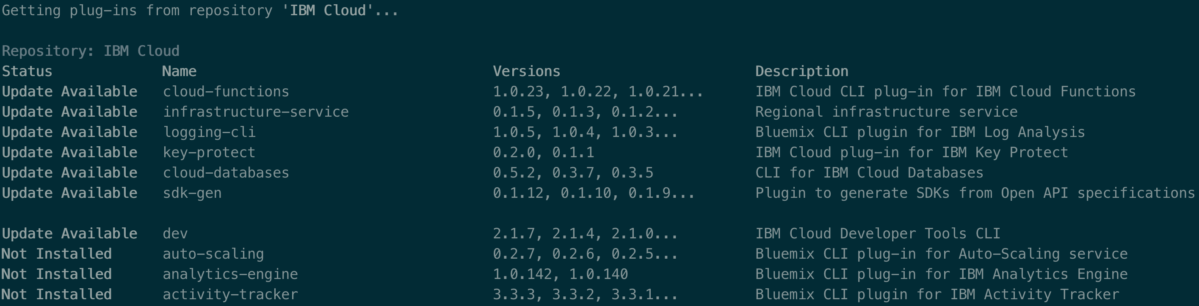
Command Line CLI Plugins
ibmcloud plugin repo-plugins -r "IBM Cloud"
Developer

Slide 57
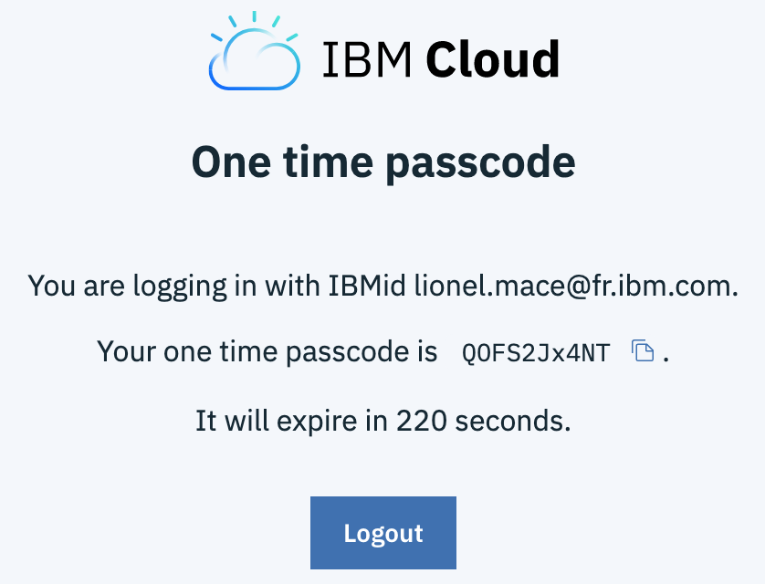
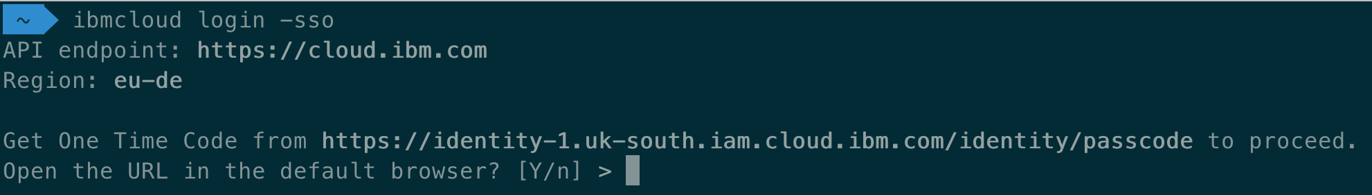
Login in to IBM Cloud CLI with a Federated ID
Get a one-time passcode by specifying the SSO parameter: ibmcloud login -sso
Follow the specified URL to get the passcode. https://iam.cloud.ibm.com/identity/passcode. In the browser, log in with with your federated id.
Copy and paste the passcode value as your input

Slide 58
11. Create Enterprise Account

Slide 59
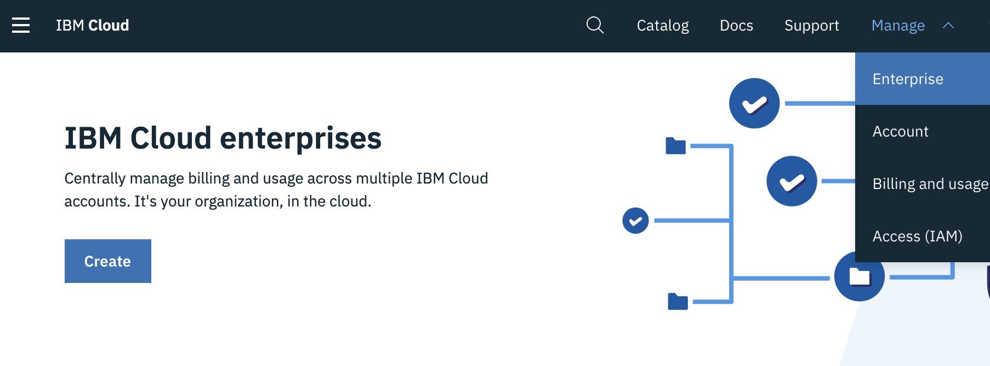
Enterprise Account
1
2

Slide 60
Enterprise Account
Enterprise Account
Account Group
Account
Account Group
Account Group
Account
Account
Account
Support complex Enterprise Hierarchy
Consolidated Billing
Nested Account Groups
Create New Account or Import Existing Account
Available in the Console or by API
Notes:
maximum depth is 5, max # of accounts is 300, and max # of account groups is 100

Slide 61
12. Enable SSL VPN Access

Slide 62
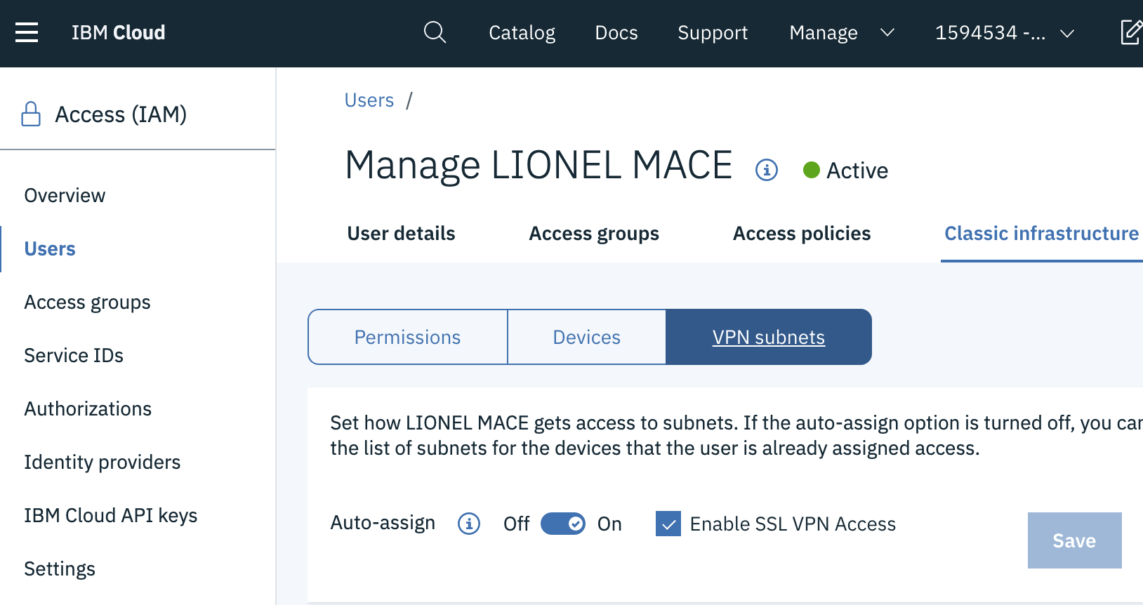

Retrieve your VPN Credentials
Select a User
Make sure « Enable SSL VPN Access » is turned on.
Scroll down to VPN password
1
3
2
http://cloud.ibm.com/users

Slide 63

Enable VPN Access
Step #1 – Select the Data Center VPN Portal
https://www.softlayer.com/VPN-Access
Ex: https://vpn.fra02.softlayer.com/ for Frankfurt
Step #2 - Install Client VPN MotionPro Plus
https://apps.apple.com/us/app/motionpro-plus/id1218085720?mt=12
Step #3 - Configure new gateway
Set the correct gateway: vpn.fra02.softlayer.com
Set the VPN User and Password

